Slide 1
A Nanotechnology-Inspired Grand Challenge for Future Computing
R. Stanley Williams
Senior Fellow
Hewlett Packard Labs

Slide 2
Outline
Brief History of OSTP Grand Challenge on “Future Computing’ announcement on 10/20
Structure of a Multidisciplinary Nanotechnology-Inspired Future Computing Program
    Chinese Brain-Inspired Computing Research Program
After Moore’s transistor shrinking is over, what’s next?
    Look to the brain for clues
    Nonlinear dynamical systems
    Nonvolatile (synaptic) and locally active (neuronic) memristors
Understanding, models and simulation
    Predict the behavior of a nonlinear dynamical system
    Calibrate and validate models
      Electrical test, and physical and chemical characterization
    Microphysical understanding
      High resolution in energy, space and time

Slide 3
A Brief History
US BRAIN Initiative - April 22, 2013
OSTP RFI: “Nanotechnology-Inspired Grand Challenges for the Next Decade” – June 17
Submitted a response to RFI entitled “Sensible Machines” – June 24
Executive Order: National Strategic Computing Initiative – July 29
OSTP shortlisted ‘Sensible Machines’, asked to ‘develop a program’ – July 30
Recruited Erik DeBenedictis of Sandia National Labs
Erik brings IEEE Rebooting Computing and ITRS on board
Presentation to National Research Council – Sept. 9
Max Planck Society sponsored workshop “Beyond CMOS” – Oct. 7-9
IEEE Non-Volatile Memory Symposium, Beijing – Oct. 12-14
Chinese Brain-Inspired Computing Research (CBICR) program, Tsinghua U. – Oct. 15
Tom Kalil announces a new Grand Challenge at NSCI workshop – Oct. 20

Slide 4
URLs for further information
White House announcement of Future Computing Grand Challenge:
https://www.whitehouse.gov/blog/2015/10/15/nanotechnology-inspired-grand-challenge-future-computing
“Create a new type of computer that can proactively interpret and learn from data, solve unfamiliar problems using what it has learned, and operate with the energy efficiency of the human brain.”
nano.gov grand challenges portal:
http://www.nano.gov/grandchallenges
IEEE Rebooting Computing Website:
http://rebootingcomputing.ieee.org/archived-articles-and-videos/general/sensible-machine
Sensible Computer White Paper:
http://rebootingcomputing.ieee.org/images/files/pdf/SensibleMachines_v2.5_N_IEEE.pdf

Slide 5
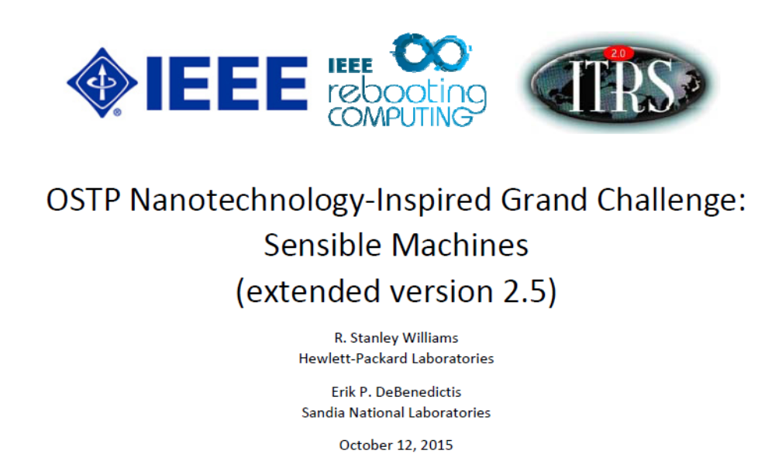

Slide 6
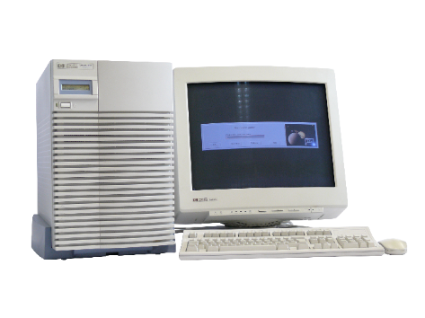
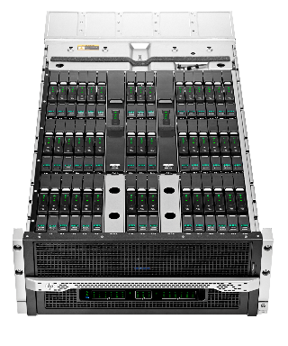
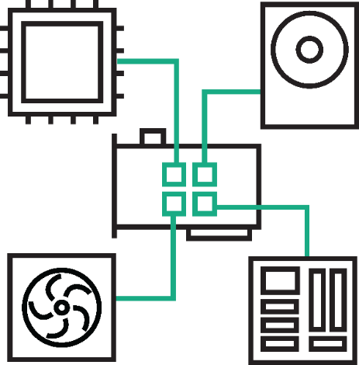

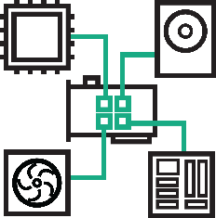
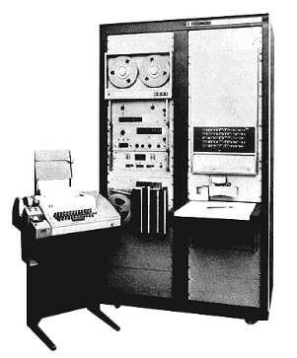
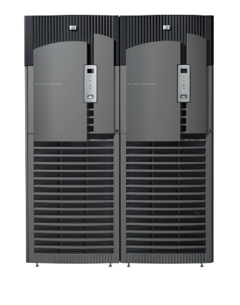
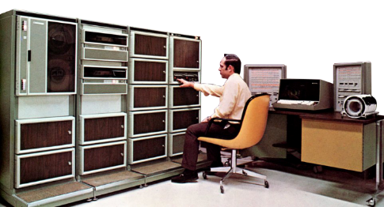
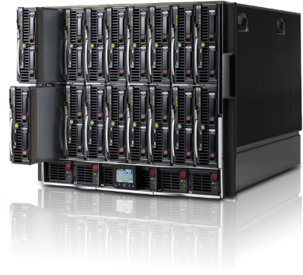
The Past 60 Years
It’s time to rethink
how computers are built
1950s
1960s
1970s
1980s
1990s
2000s
Today
Notes:
The central reason that we’re staring down the looming problems is that we’ve been doing the same thing for 60 years.
General purpose processors, copper connectors, with tiers of memory and storage, all on a transactional system.
It’s time to stop.
I’m here to give you a peek behind the curtain of Hewlett Packard Labs. Show you an ambitious research project to rethink how computers are built, from the ground up.
From left to right:
P2116A
3000
3000
HP9000 J280 Workstation
Integrity Superdome
C-Class c7000
Moonshot

Slide 7
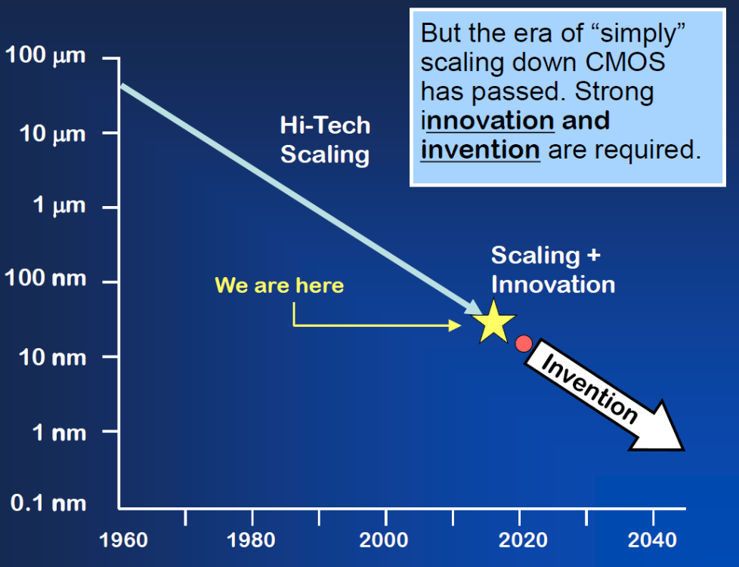
Moore’s Law transistor scaling is finally ending
14 nm circuits are shipping now
5nm is now viewed as the end of Moore’s law, based on either physics or economics circa 2021!
Challenges in getting below 10 nm: EUV or quadruple exposure immersion patterning
Single monolayer thick active layers inside the devices
Future improvements come from new materials, structures and architectures
Feature Size
(From Victor Zhirnov, Semiconductor Research Corporation)

Slide 8
The end of cheap hardware
Compute is not keeping up with data
Data
(Zettabytes)
10⁷
Transistors
(thousands)
2020
10⁶
Data nearly doubles every 2 years
(2013-2020)
10⁵
Single-thread
Performance
(SpecINT)
10⁴
Frequency
(MHz)
10³
Typical Power
(Watts)
10²
Number of Cores
10¹
10⁰
2013
2009
1975
1980
1985
1990
1995
2000
2005
2010
2015
Years
Notes:
Detail dive on “The End of Cheap Hardware”

Slide 9
The “Sensible Machine” response to OSTP RFI
The central thesis of this white paper is that although our present understanding of brains is limited, we know enough now to design and build circuits that can accelerate certain computational tasks; and as we learn more about how brains communicate and process information, we will be able to harness that understanding to create a new exponential growth path for computing technology.
Our challenge as a community is now to perform more computation per unit energy rather than manufacture more transistors per unit area.

Slide 10
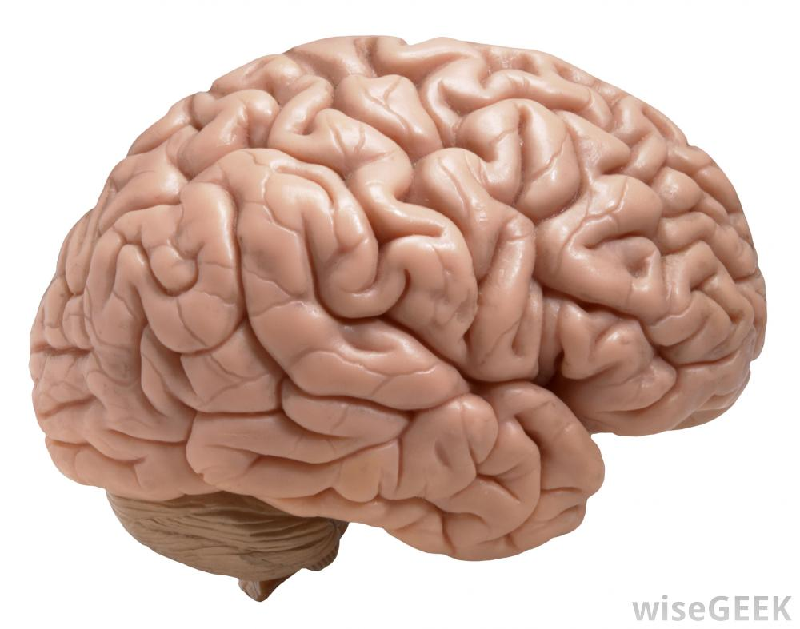
Inspiration from the brain: remarkable power efficiency
<25 Watts @ 100 Hz
What are the state variables for communication and computation?
Ion currents and molecular concentrations:
very slow, high energy and inefficient!
How is information processed by a nonlinear dynamical system?
Notes:
Apr 2007 Blue Gene /L with 4e3 processors ran a simulation of half a mouse brain (8 million neurons, up to 6300 synapses [no total synapse # provided]) for 10 seconds (only 1 s in the mouse brain).

Slide 11
Structure of a Neuromorphic Computing Program
Example: Chinese Brain-Inspired Computing Research
Tsinghua University:
Operating for three years
35 faculty from seven departments in eight groups
Well conceived, led and funded (internally by Tsinghua)
Already fabbed two chips with a third taped out
Planning to expand program internationally

Slide 12
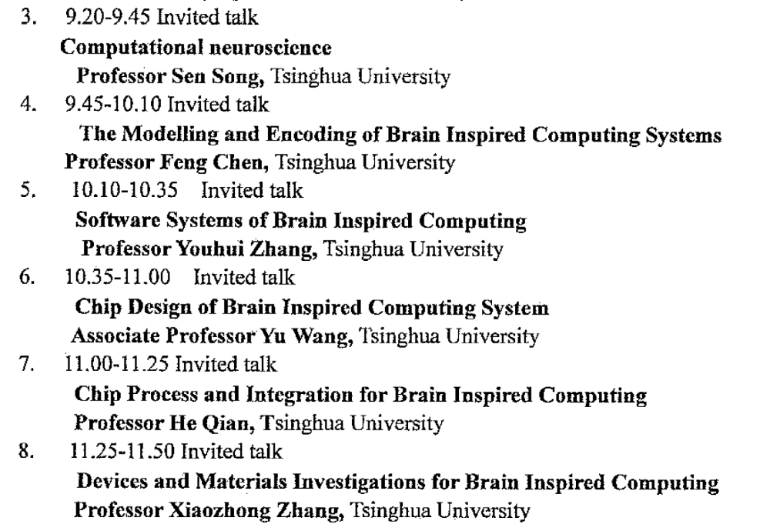
Review of CIBCR, Tsinghua U.

Slide 13
Structure of a US Nanotechnology-Inspired Future Computing Program
1. Connect Theory of Computation with Neuroscience and Nonlinear Dynamics
e.g. Boolean, CNN, Baysian Inference, Energy-Based Models, Markov Chains
2. Architecture of the Brain and Relation to Computing and Learning
Theories of Mind: Albus, Eliasmith, Grossberg, Mead, many others
3. Simulation of Computational Models and Systems
4. System Software, Algorithms & Apps – Make it Programmable/Adaptable

Slide 14
Structure of a US Nanotechnology-Inspired Future Computing Program
5. Chip Design – System-on-Chip: Accelerators, Learning and Controllers
Compatible with standard processors, memory and data bus
6. Chip Processing and Integration – Full Service Back End of Line on CMOS
DoE Nanoscale Science Research Centers (NSRCs) – e.g. CINT
7. Devices and Materials – in situ and in operando test and measurement
Most likely materials will be adopted from Non-Volatile Memory

Slide 15
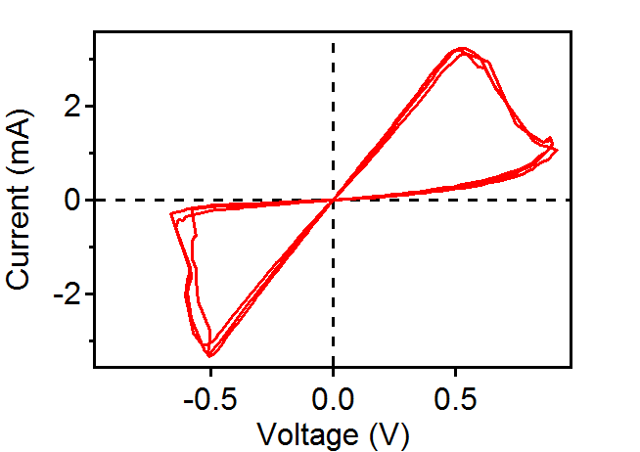
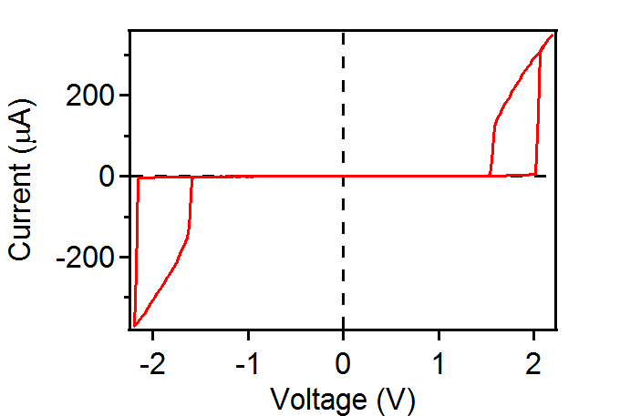
Memristors have ‘pinched’ hysteresis loops
Leon Chua, IEEE Trans. Circuit Theory 18, 507 (1971).
Nonvolatile Memristor
- Emerging digital memory/storage
- Synapse in neuromorphic circuit
Locally Active (e.g. “Mott”) memristor
- Emerging neuronal compute device
- Passive “selector” in crossbar memories

Slide 16
Two types of memristors:
Locally Active:
‘Neuronic’ and/or ‘Axonic’
State transmitted as spike
Looks digital
Threshold switching, NDR
Gain, oscillations, chaos
Mott transitions - oxides
Amorphous Ge-Sb-Te
Nonvolatile:
‘Synaptic’
State stored as resistance
Continuously variable
Many Examples
ReRAM – vacancies in oxides
PC RAM – Ge-Sb-Te
STT RAM – spins (binary)

Slide 17
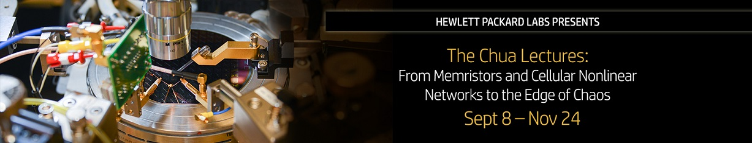
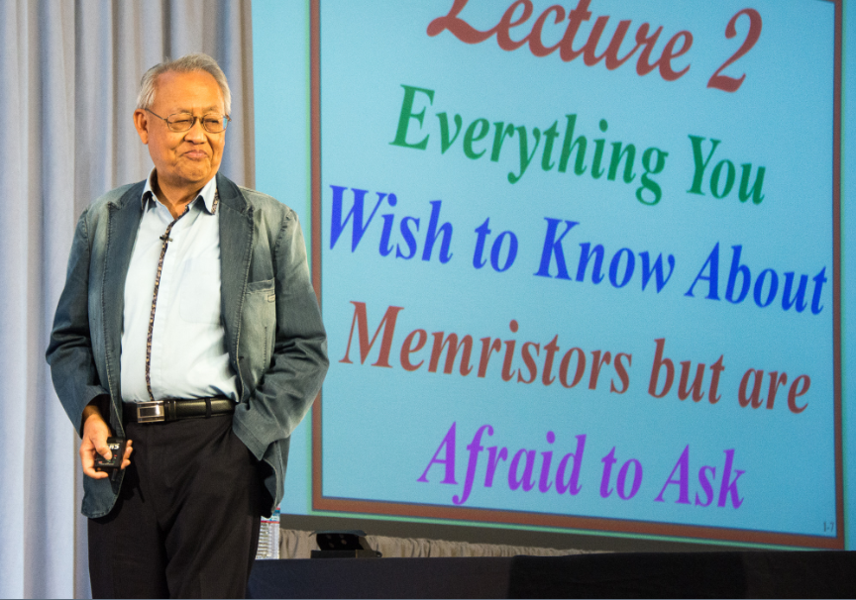
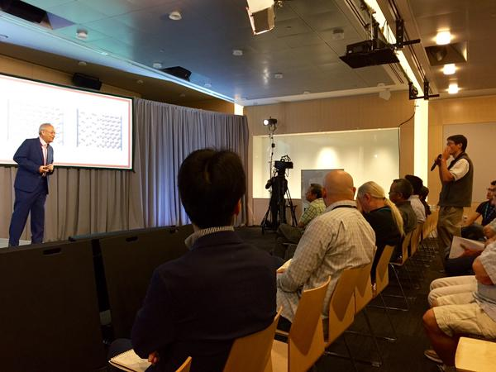
Hewlett Packard Labs is kicking off an exciting 12-part lecture series with the world-renowned Professor Leon Chua – accomplished IEEE Fellow, Professor of Electrical Engineering and Computer Sciences at UC Berkeley, and a pioneer in neural network and Memristor research.
Over the course of the 12 weekly lectures, Professor Chua will offer a peek into his life’s work exploring distinct research areas which have emerged from highly nonlinear and dynamical phenomena including: Memristors, Cellular Nonlinear Networks (CNN), The Local Activity Principle and the Edge of Chaos.
Don’t miss this rare opportunity to hear from one of the greatest thought leaders of our industry. ‘Linearize then analyze’ is no longer valid for understanding nanodevices or neurons – a new mathematical theory of electronics is needed, and was developed 35 years ago!
Event details:
What: Chua Lecture Series
When: Every Tuesday starting September 8 through November 24, 10:30 a.m. – 12:00 p.m. Pacific Time
How to attend: Register here – Attend in person or on the web.
We highly recommend that you take the opportunity to hear the Professor Chua lectures in person at Building 20 Auditorium in Palo Alto.
Register for upcoming lecture and scroll down the registration page to sign up for the entire lecture series. This is open to everyone so feel free to share this event with your colleagues, friends and social networks!

Slide 18
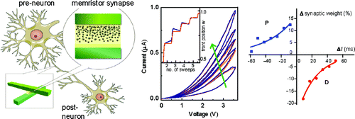
Viable path toward scalable biomimetic computing?
Neuron (neuristor)
Locally active memristors
Captures key features of the brain:
1) Non-linear dynamics (“edge of chaos”) of neurons
2) High density architecture, localized memory
i.e. not the von Neuman architecture with physically separated compute and memory !
3) Massive parallelism
Synapse
Nonvolatile memristors
Sung Hyun Jo, et al. Nano Lett. 10, 1297 (2010)

Slide 19
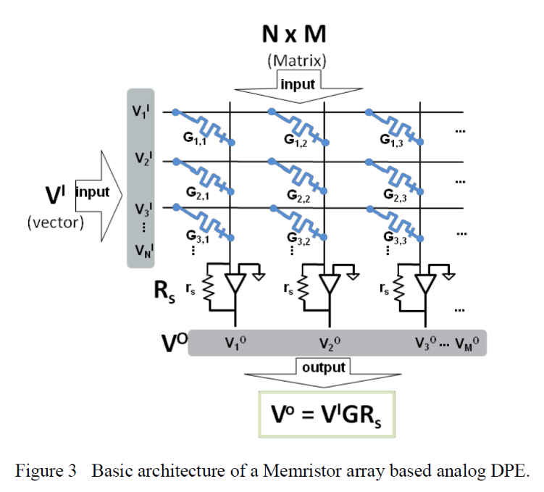
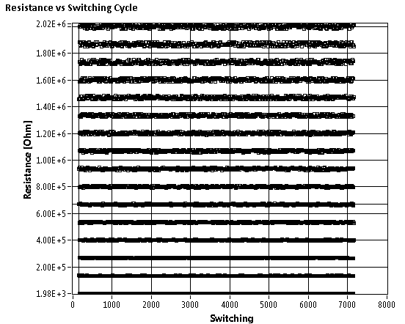
Accelerates many workloads
FFT, Metropolis-Hastings, Simulated Annealing
Computing application of nonvolatile memristors
Memristor array = matrix G_{ij}
Requires non-binary states for each memristor
Computes Matrix-vector dot product V^{I} * G in one time step

Slide 20
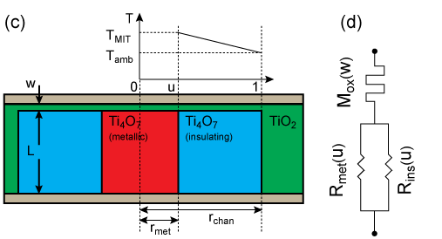
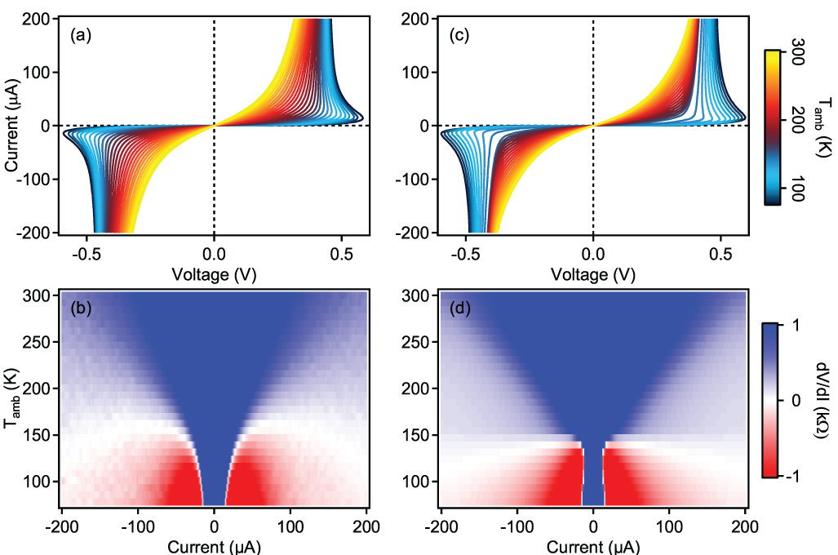
Identification of local activity (NDR) in caused by a Mott transistion
Insulator-metal transitions in metal oxides provide a new functionality we can exploit
Negative Differential Resistance provides a natural route to computing
Data
Simulation
Data
Simulation
Current through device → Joule heating → growing metallic phase within Ti₄O₇
M. D. Pickett, et al. Advanced Materials, (2011)

Slide 21
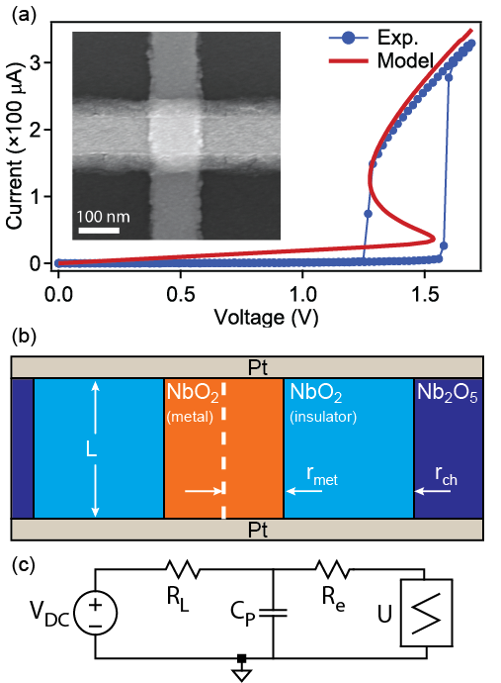
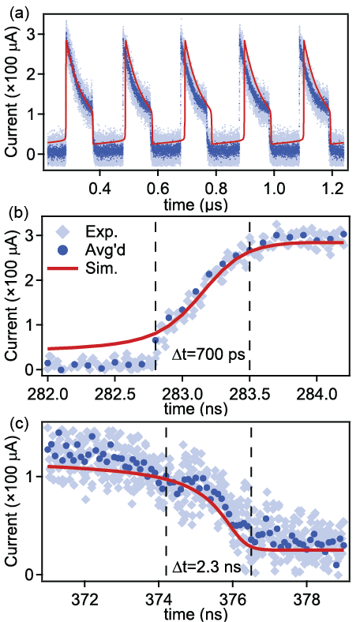
NbO₂ Locally Active “Mott” Memristor – thermoelectric switching
Oscillator with DC bias!
r_{ch} =
30 nm

Slide 22
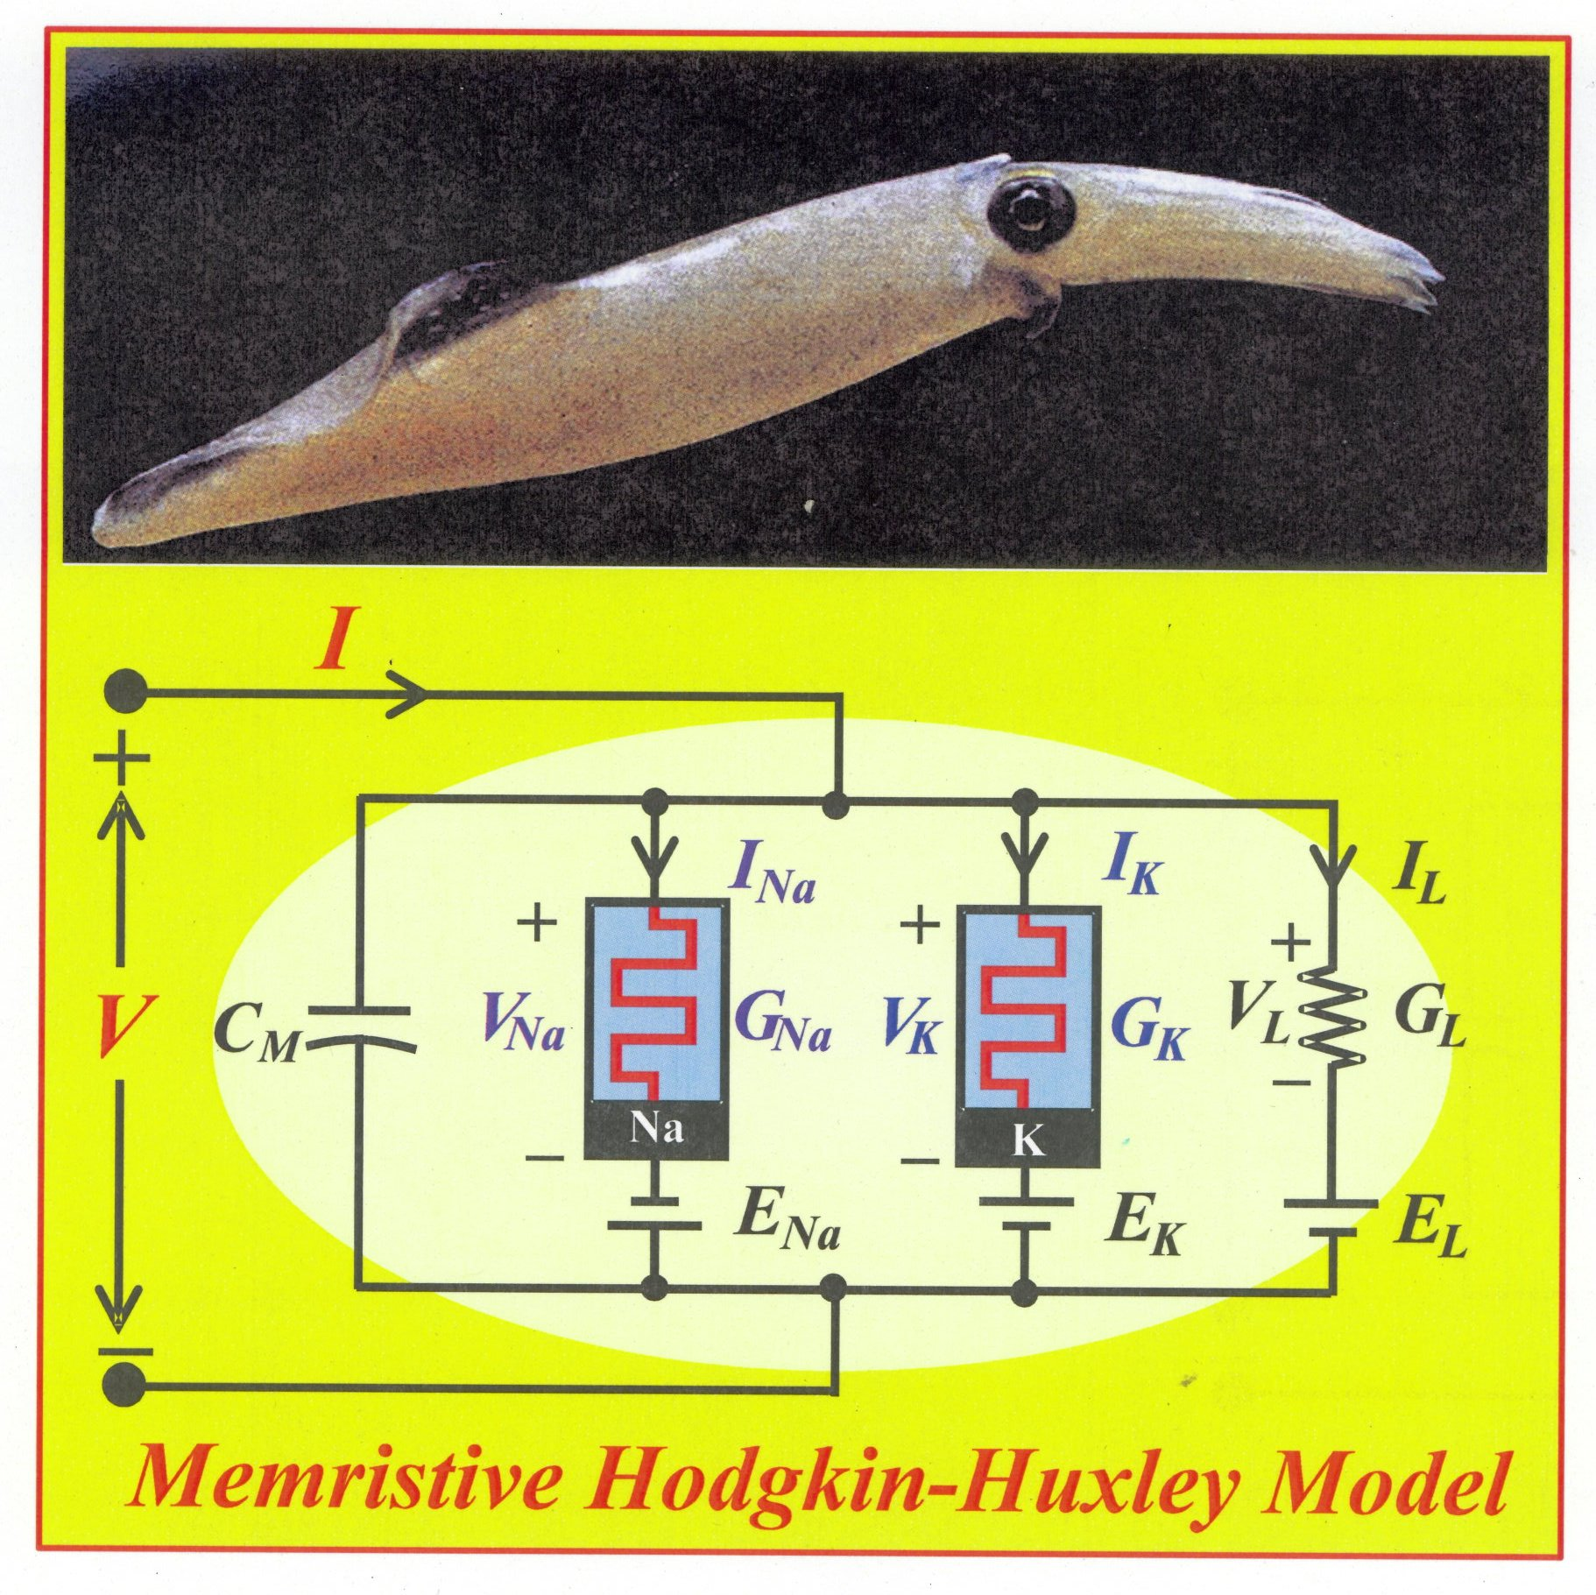
Leon Chua’s Version of the Hodgkin-Huxley Model
L. Chua et al., “Hodgkin-Huxley Axon is made of Memristors,”
International Journal of Bifurcation and Chaos 22 (2012) art. # 1230011.

Slide 23
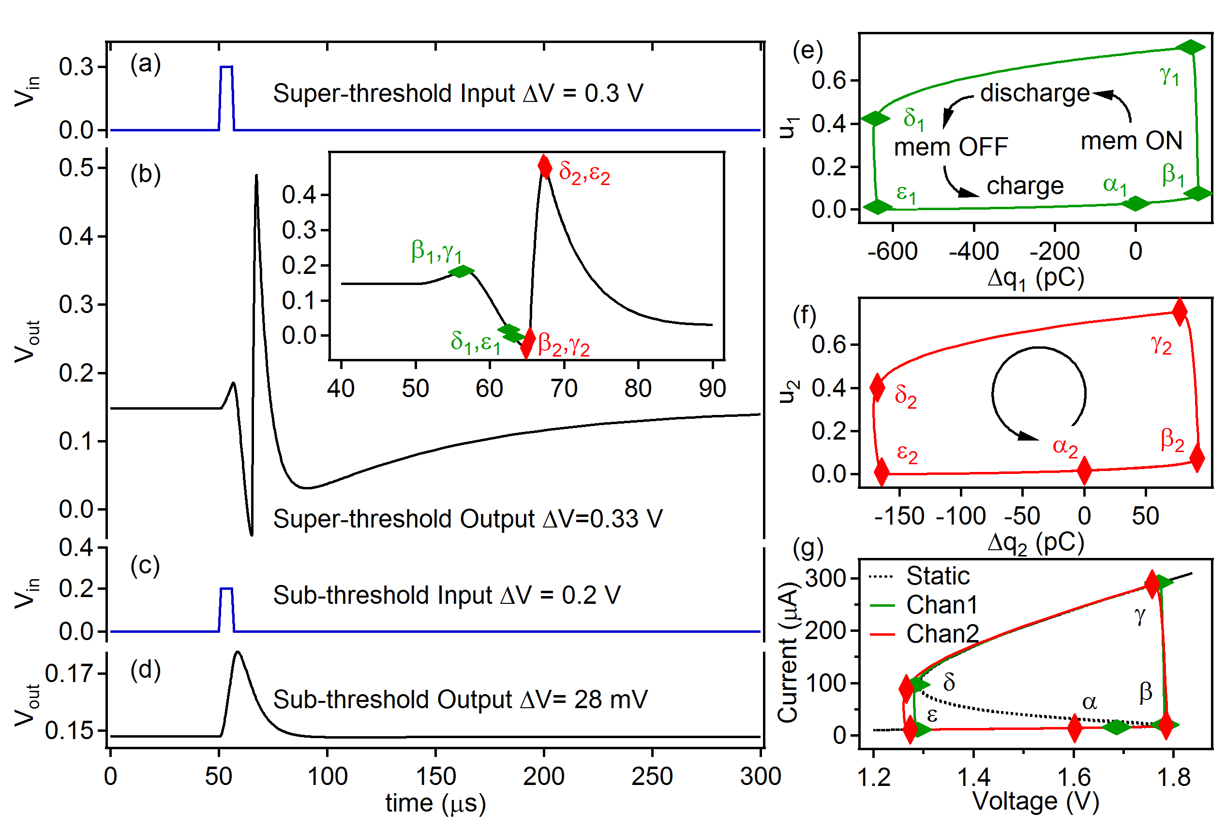
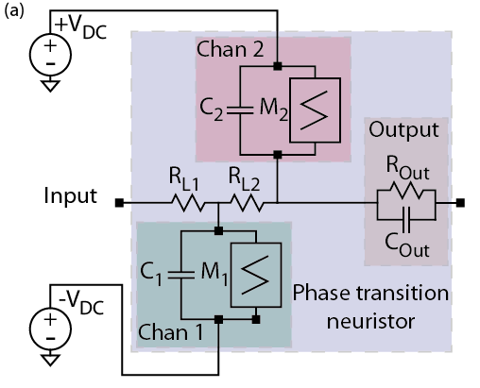
A Neuristor inspired by the Hodgkin-Huxley model
Implements “All or Nothing” spiking:
500 times faster than a neuron
1% of the energy of a neuron
M. D. Pickett, et al, Nature Materials 12, 114 (2013).

Slide 24
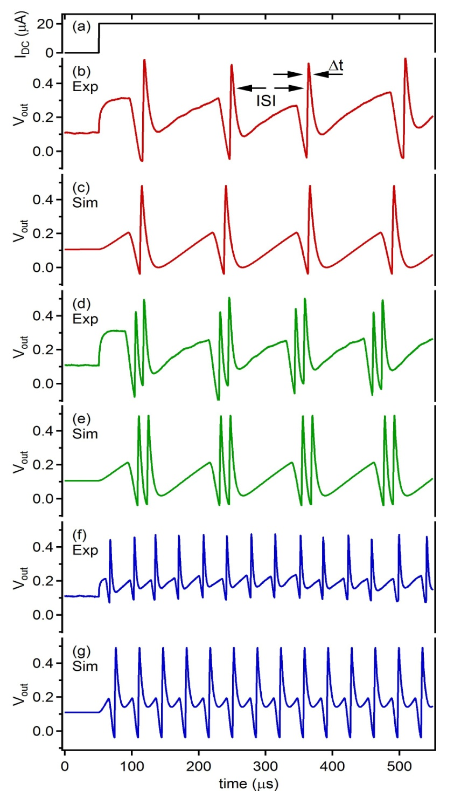
Neuristor spiking emulates action potential seen in brains
“Regular Spiking”
C₁=5.1 nF, C₂=0.75 nF
“Chattering”
C₁ = 5.1 nF, C₂ = 0.5 nF
“Fast Spiking”
C₁=1.6 nF, C₂=0.5 nF

Slide 25
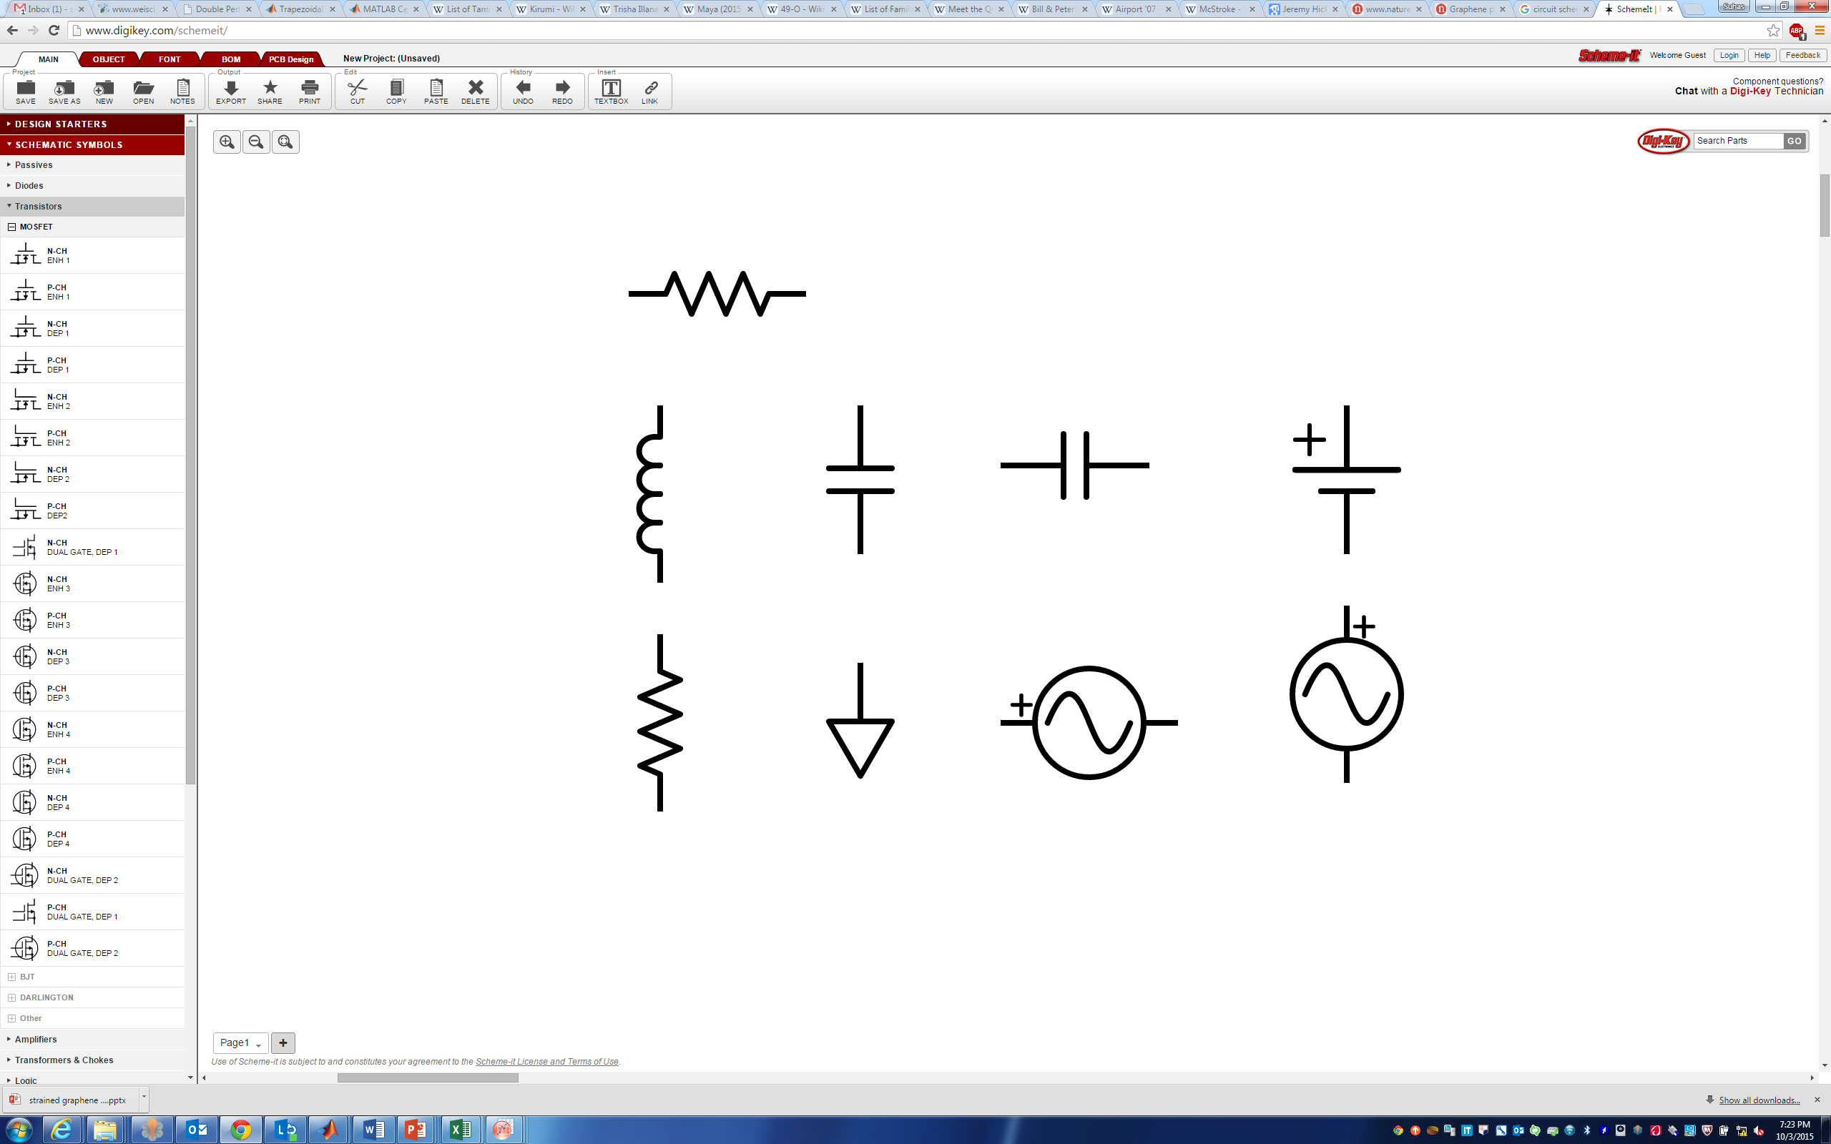
Integrated Mott memristors – thermoelectric design
Pt top electrode
TiN
NbO_{x}
T_{N}
R_{th}C_{th} ≤ 0.1 ns
R_{th} ≥ 10⁶ K/W
C_{th} ≤ 10⁻¹⁶ J/K
10x faster
0.1x energy
of previous device
R_{th}
C_{e}
SiO₂
≤ 0.1 nF
TiN
Nanovia
C_{th}
SiN_{x}
T_{amb}
W bottom electrode
Dark field cross-sectional TEM image of NbO_{x} memristor. The heated region is thermally connected to T_{amb} through the effective thermal resistance, R_{th}, and thermal capacitance, C_{th}.

Slide 26
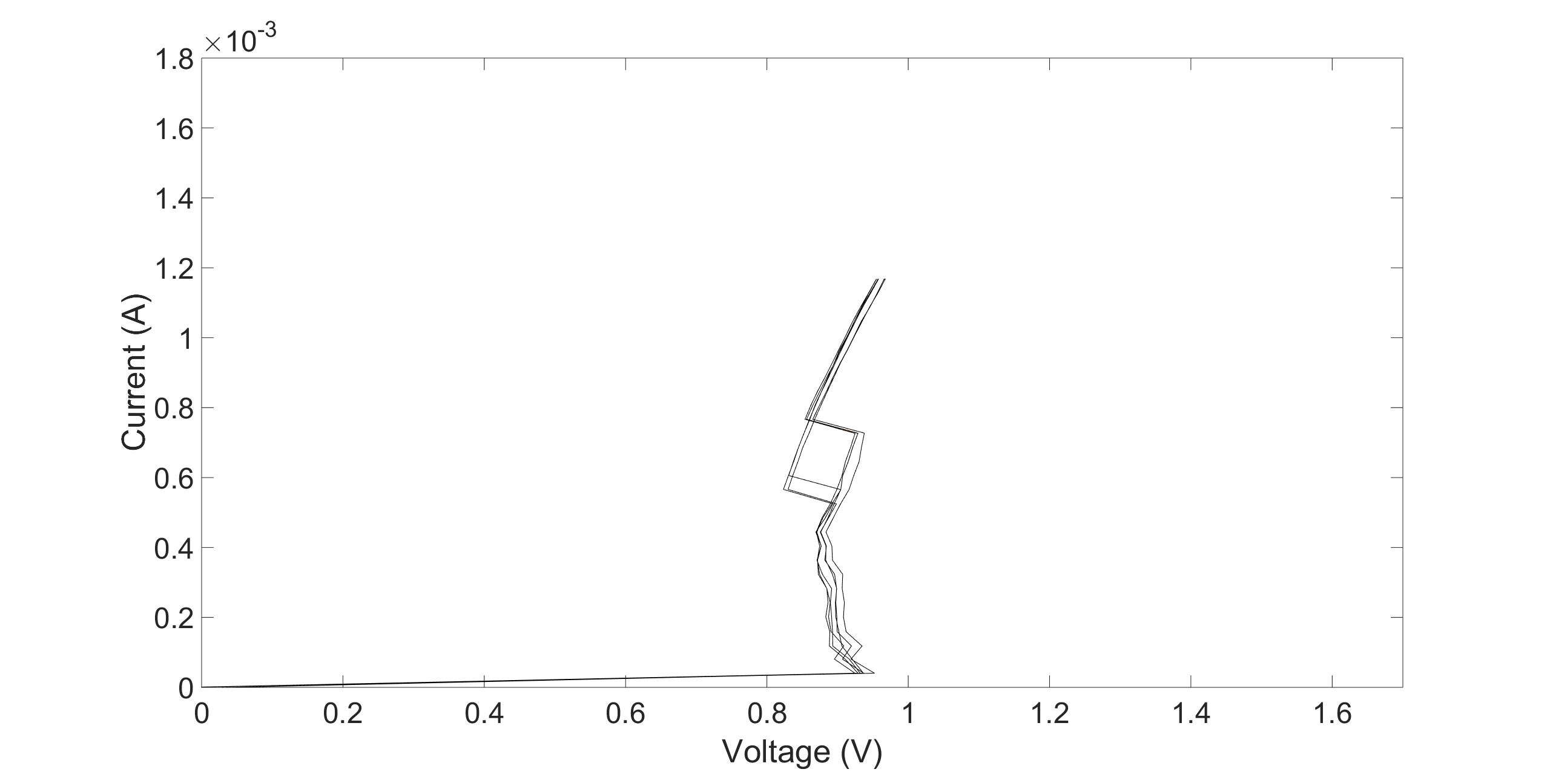
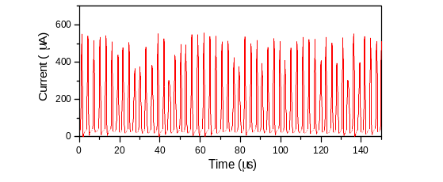
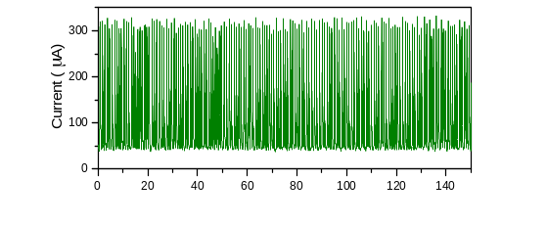
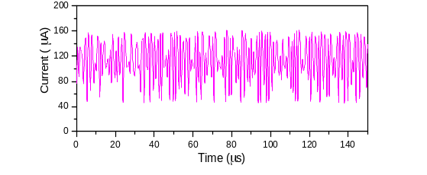
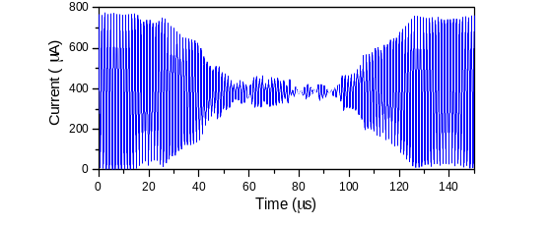
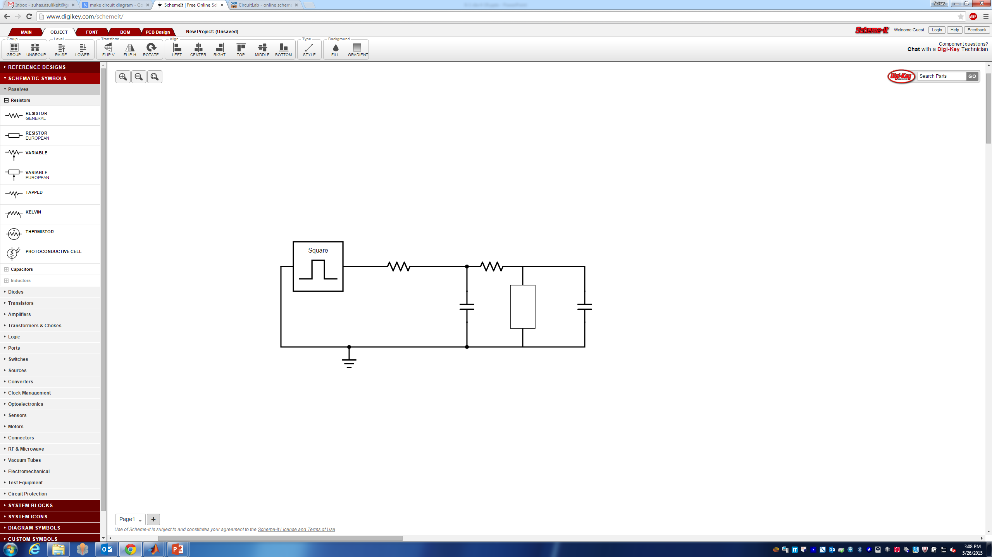
New NbO₂ memristor displays oscillatory and chaotic behavior
Oscillations and chaos depend sensitively on DC bias
DC characteristics
0.96 V
1.00 V
Oscillations
1.03 V
1.20 V
Oscillations
R1=1kΩ
R2
C1=1nF
M
C2

Slide 27
Grand Challenge addresses a larger community than just nano
Need to go beyond NNI and involve diverse creative communities
Information technology requires a system-level awareness: Architecture
  Nano devices and circuits will be necessary, but not sufficient for a paradigm shift
  Also need insights from neurophysiology (circuits) and psychology (algorithms)
Revolutionary advances disguised as evolutionary to gain market acceptance
  A new nanodevice is useless if it requires a major change (i.e. expense) to a system or to manufacturing processes (customers don’t pay for performance – they expect it)
  Two-thirds (or more) of any computing system today is design and software
Avoid fads and bandwagons (e.g. Graphene and Deep Learning)
  Need a broad investment portfolio of competing technologies and ideas
Multi-disciplinarity is essential – need experts in each domain who can communicate, not lots of broad but shallow neophytes

Slide 28
Acknowledgments
Erik P. DeBenedictis, Sandia National Laboratories
Thomas M. Conte, Georgia Tech
Paolo A. Gargini, ITRS
David J. Mountain, LPS
Elie K. Track, nVizix
IEEE Rebooting Computing

