Slide 1
DoE
Neuromorphic Computing Study Group
Stan Williams
Senior Fellow
Hewlett Packard Labs, Palo Alto, CA
October 29, 2015

Slide 2
Outline
Brief History leading to OSTP Grand Challenge on “Future Computing’ announcement on 10/20
Structure of a Multidisciplinary Neuromorphic Computing Program
    DoE has many, but perhaps not all, of the components for a successful program
After Moore’s transistor shrinking is over, what’s next?
    Look to the brain for clues
    Nonlinear dynamical systems
    Nonvolatile (synaptic) and locally active (neuronic) memristors
Understanding, models and simulation
    Predict the behavior of a nonlinear dynamical system
    Calibrate and validate models
      Electrical test, and physical and chemical characterization
    Microphysical understanding
      High resolution in energy, space and time
Challenge - watching nanoscale devices operate on nanosecond time scales

Slide 3
A Brief History
US BRAIN Initiative - April 22, 2013
OSTP RFI: “Nanotechnology-Inspired Grand Challenges for the Next Decade” – June 17, 2015
Submitted a response to RFI entitled “Sensible Machines” – June 24
Executive Order: National Strategic Computing Initiative – July 29
Response from OSTP: Sensible Machines shortlisted, asked to ‘develop a program’ – July 30
A flurry of activity! – Aug-Sept
Enlisted the assistance of IEEE Rebooting Computing and ITRS – especially Erik DeBenedictis
Presentation to National Research Council – Sept. 9
Max Planck Society sponsored workshop “Beyond CMOS” – Oct. 7-9
IEEE Non-Volatile Memory Symposium, Beijing – Oct. 12-14
Reviewed Chinese Brain-Inspired Computing Research (CBICR) program – Oct. 15
Tom Kalil announces a new Grand Challenge at NSCI workshop – Oct. 20
“to develop transformational computing capabilities by combining innovations in multiple scientific disciplines”

Slide 4
URLs for further information
White House announcement of Grand Challenge:
https://www.whitehouse.gov/blog/2015/10/15/nanotechnology-inspired-grand-challenge-future-computing
nano.gov grand challenges portal:
http://www.nano.gov/grandchallenges
IEEE Rebooting Computing Website:
http://rebootingcomputing.ieee.org/archived-articles-and-videos/general/sensible-machine
Sensible Computer White Paper:
http://rebootingcomputing.ieee.org/images/files/pdf/SensibleMachines_v2.5_N_IEEE.pdf

Slide 5
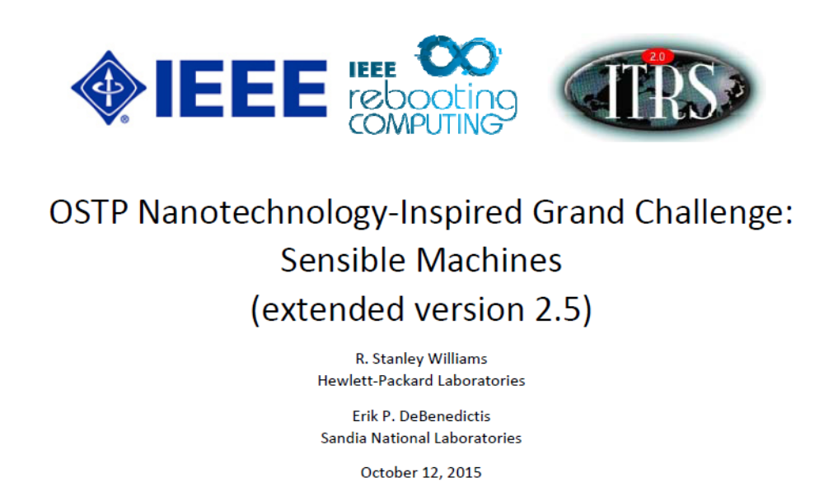

Slide 6
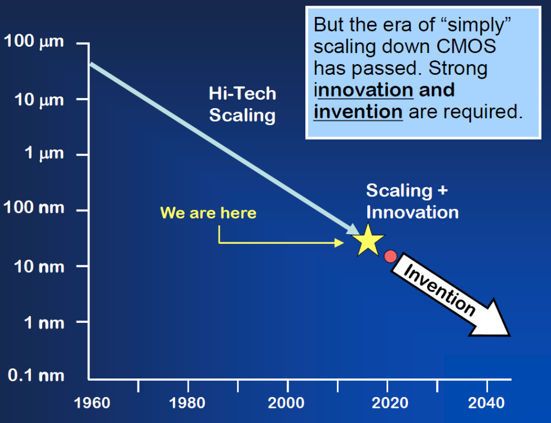
Moore’s transistor scaling is finally ending
14 nm circuits are shipping now
5nm is now viewed as the end of Moore’s law, based on either physics or economics circa 2021!
Challenges in getting below 10 nm: EUV or quadruple exposure immersion patterning
Single monolayer thick active layers inside the devices
Future improvements come from new materials, structures and architectures
Feature Size
(From Victor Zhirnov, Semiconductor Research Corporation)

Slide 7
The “Sensible Machine” response to OSTP RFI
The central thesis of this white paper is that although our present understanding of brains is limited, we know enough now to design and build circuits that can accelerate certain computational tasks; and as we learn more about how brains communicate and process information, we will be able to harness that understanding to create a new exponential growth path for computing technology.
I believe this statement much more now than when I first wrote it.

Slide 8
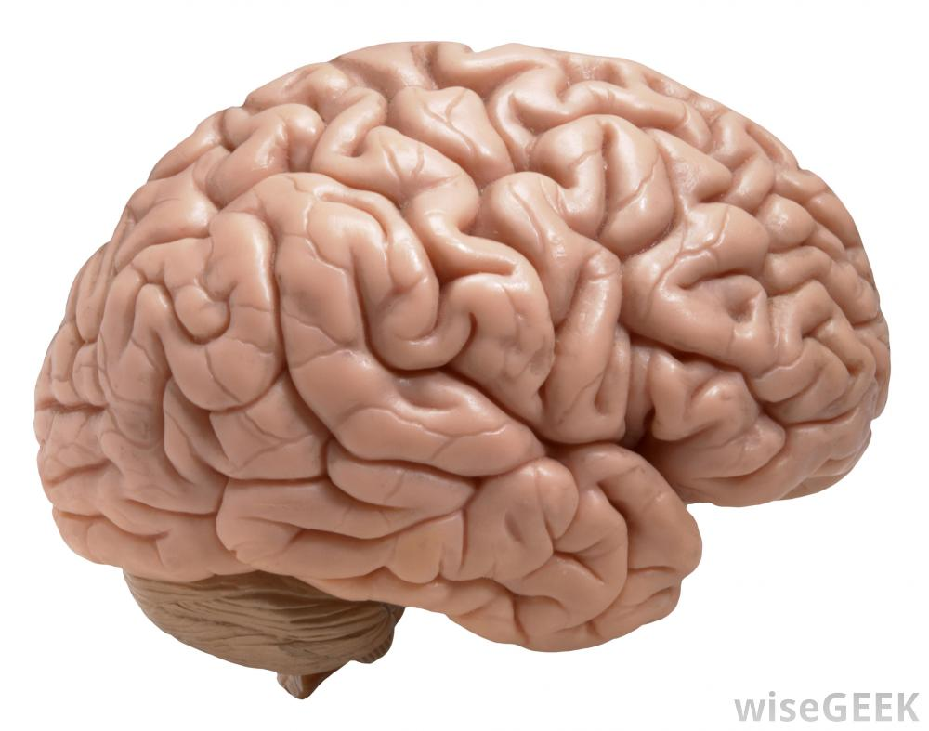
A model in power efficiency
<25 Watts @ 100 Hz
What are the state variables for communication and computation?
Ion currents and molecular concentrations:
very slow, high energy and inefficient!
How is information processed by an extremely nonlinear dynamical system?
Notes:
Apr 2007 Blue Gene /L with 4e3 processors ran a simulation of half a mouse brain (8 million neurons, up to 6300 synapses [no total synapse # provided]) for 10 seconds (only 1 s in the mouse brain).

Slide 9
Structure of a Neuromorphic Computing Program
Look at existing programs in China: three in Beijing
Peking University
Academia Sinica
Tsinghua University – CBICR program
Operating for three years
35 faculty from seven departments in eight groups
Well conceived, led and funded (internally by Tsinghua)
Already fabbed two chips with a third taped out
Wants to expand program internationally

Slide 10
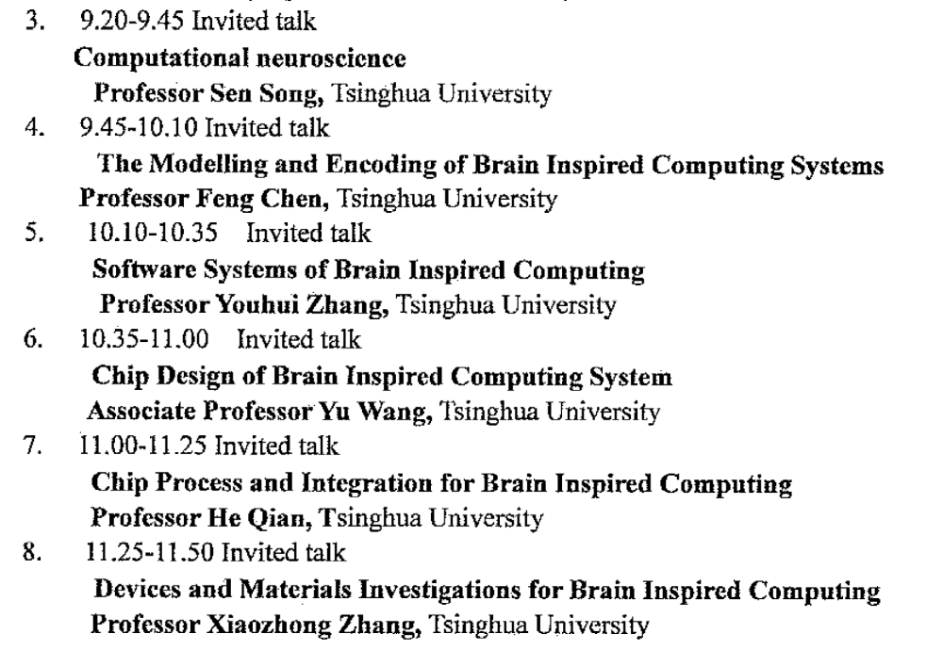
Review of CIBCR Tsinghua U.

Slide 11
Structure of a US Neuromorphic Computing Program
1. Connect Theory of Computation with Neuroscience and Nonlinear Dynamics
e.g. Boolean, CNN, Baysian Inference, Energy-Based Models, Markov Chains
2. Architecture of the Brain and Relation to Computing and Learning
Theories of Mind: Albus, Eliasmith, Grossberg, Mead, many others
3. Simulation of Computational Models and Systems
4. System Software, Algorithms & Apps – Make it Programmable/Adaptable
5. Chip Design – System-on-Chip: Accelerators, Learning and Controllers
Compatible with standard processors, memory and data bus
6. Chip Processing and Integration – Full Service Back End of Line on CMOS
DoE Nanoscale Science Research Centers (NSRCs) – e.g. CINT
7. Devices and Materials – in situ and in operando test and measurement

Slide 12
Two types of devices (memristors):
Locally Active:
‘Neuronic’ and/or ‘Axonic’
State transmitted as spike
Looks digital
Threshold switching, NDR
Gain, oscillations, chaos
Mott transitions - oxides
Amorphous Ge-Sb-Te
Nonvolatile:
‘Synaptic’
State stored as resistance
Continuously variable
Many Examples
ReRAM – vacancies in oxides
PC RAM – Ge-Sb-Te
STT RAM – spins (binary)

Slide 13
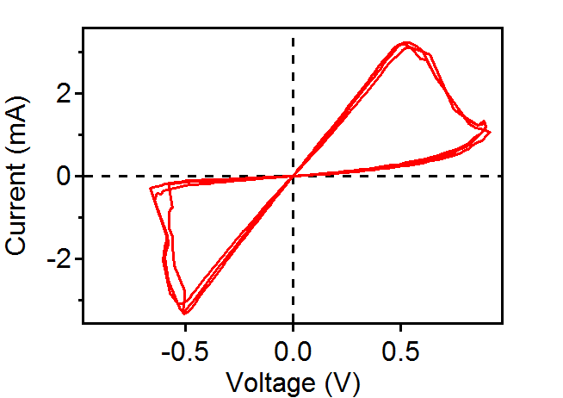
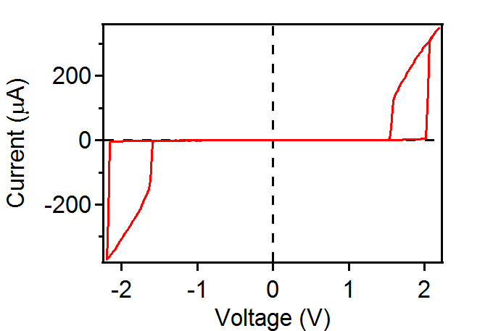
Memristors have ‘pinched’ hysteresis loops
Leon Chua, IEEE Trans. Circuit Theory 18, 507 (1971).
Nonvolatile Memristor
- Emerging digital memory/storage
- Synapse in neuromorphic circuit
Locally Active (e.g. “Mott”) memristor
- Emerging neuronal compute device
- Passive “selector” in crossbar memories

Slide 14
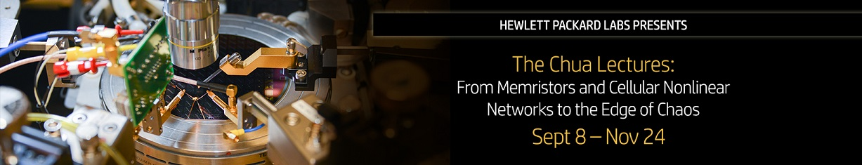
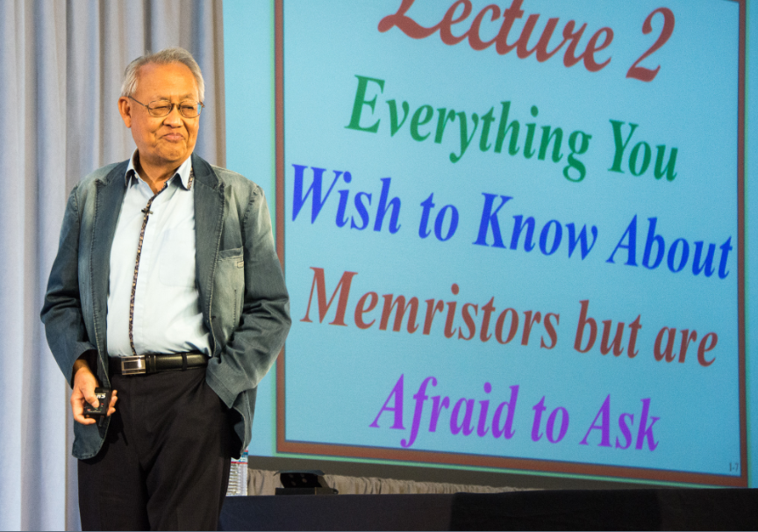
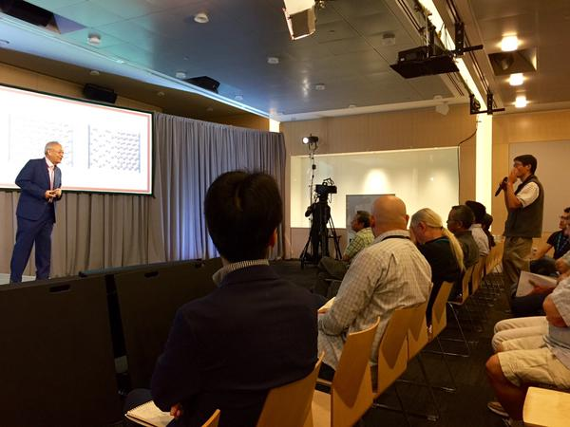
Hewlett Packard Labs is kicking off an exciting 12-part lecture series with the world-renowned Professor Leon Chua – accomplished IEEE Fellow, Professor of Electrical Engineering and Computer Sciences at UC Berkeley, and a pioneer in neural network and Memristor research.
Over the course of the 12 weekly lectures, Professor Chua will offer a peek into his life’s work exploring distinct research areas which have emerged from highly nonlinear and dynamical phenomena including: Memristors, Cellular Nonlinear Networks (CNN), The Local Activity Principle and the Edge of Chaos.
Don’t miss this rare opportunity to hear from one of the greatest thought leaders of our industry. ‘Linearize then analyze’ is no longer valid for understanding nanodevices or neurons – a new mathematical theory of electronics is needed, and was developed 35 years ago!
Event details:
What: Chua Lecture Series
When: Every Tuesday starting September 8 through November 24, 10:30 a.m. – 12:00 p.m. Pacific Time
How to attend: Register here – Attend in person or on the web.
We highly recommend that you take the opportunity to hear the Professor Chua lectures in person at Building 20 Auditorium in Palo Alto.
Register for upcoming lecture and scroll down the registration page to sign up for the entire lecture series. This is open to everyone so feel free to share this event with your colleagues, friends and social networks!

Slide 15
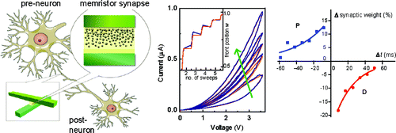
Viable path toward scalable biomimetic computing?
Neuron (neuristor)
Locally active memristors
Captures key features of the brain:
1) Non-linear dynamics (“edge of chaos”) of neurons
2) High density architecture, localized memory
i.e. not the von Neuman architecture with physically separated compute and memory !
3) Massive parallelism
Synapse
Nonvolatile memristors
Sung Hyun Jo, et al. Nano Lett. 10, 1297 (2010)

Slide 16
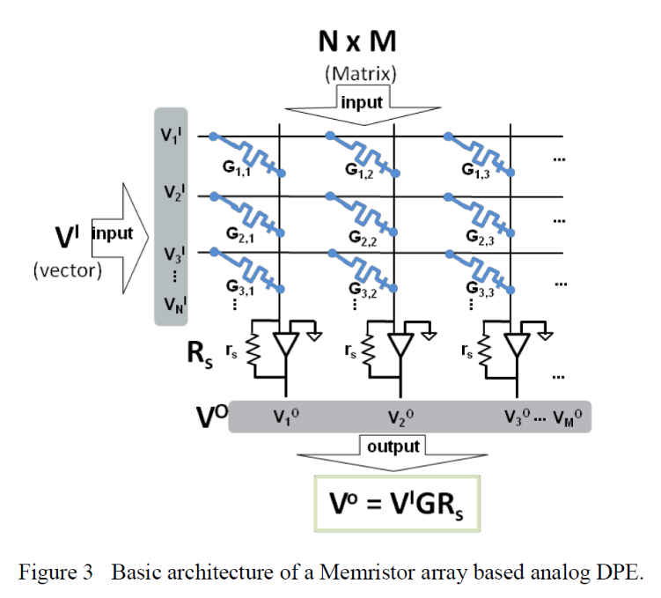
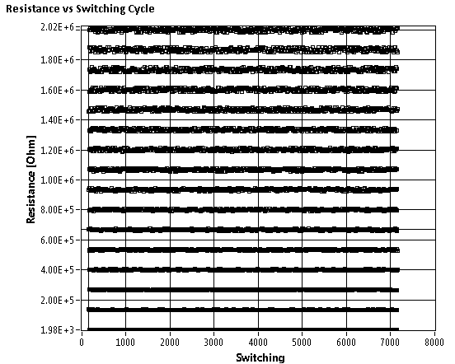
Accelerates many workloads
FFT, Metropolis-Hastings, Simulated Annealing
Analog applications of nonvolatile memristors
Memristor array = matrix G_{ij}
Requires non-binary states for each memristor
Computes Matrix-vector dot product V^{I} * G in one time step

Slide 17
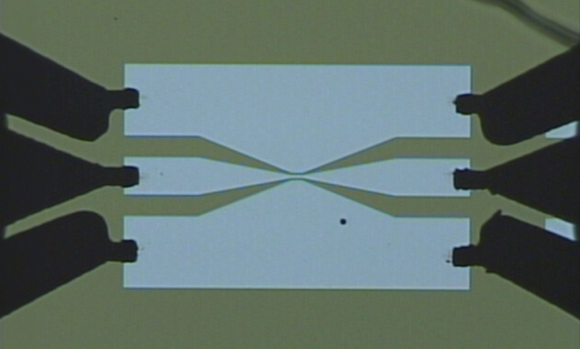
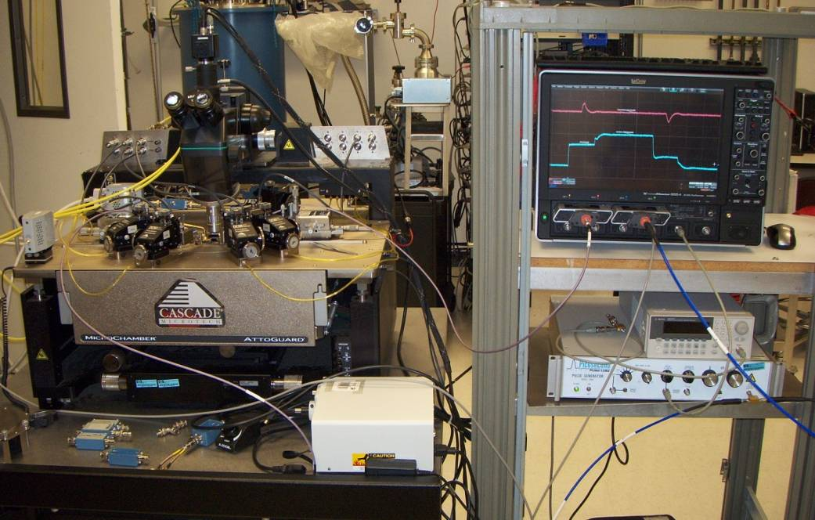
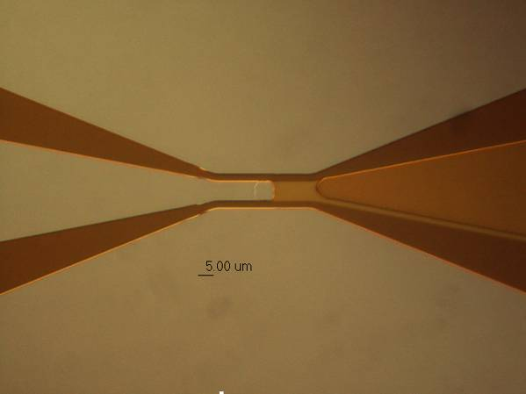
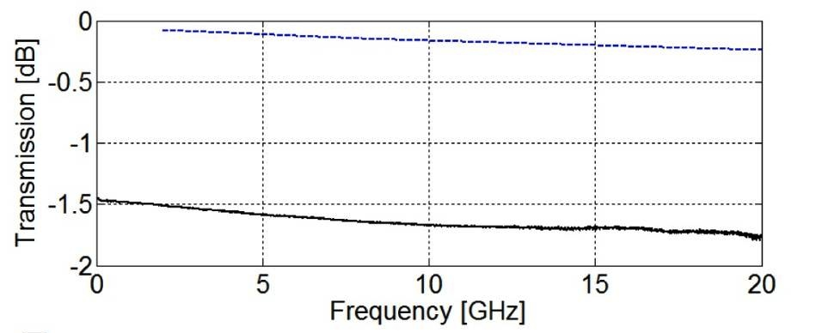
Need for high speed dynamic electrical testing
Real-time Oscilloscope
Coplanar Waveguide
200 μm
Memristor
Top Electrode
Bottom Electrode
Fast pulse generator
> 30 GHz bandwidth
A. C. Torrezan, et al., Nanotechnology, 22, 485203 (2011)
J. P. Strachan, et al., Nanotechnology, 22, 505402 (2011)

Slide 18
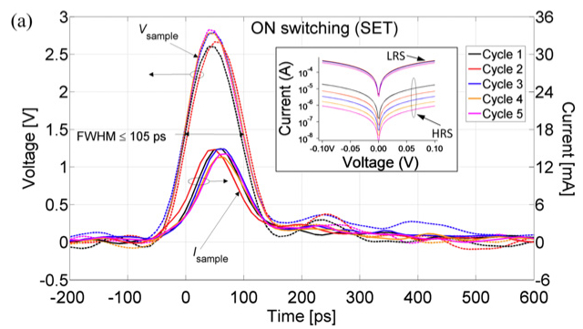
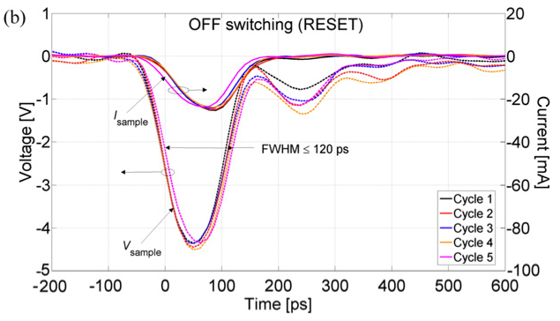
~100 ps ON and OFF switching in TaO_{x}

Slide 19
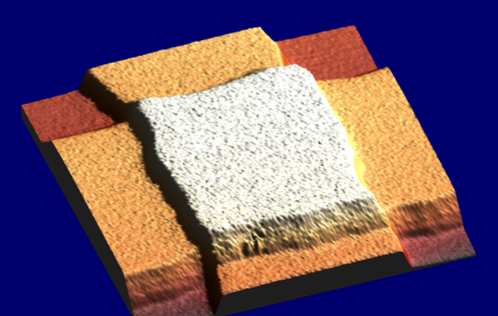
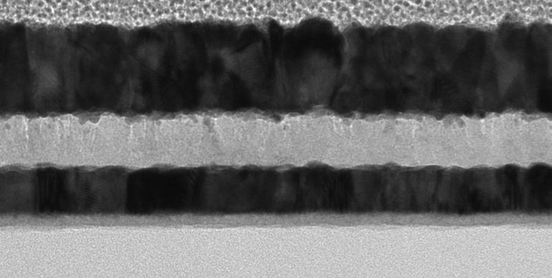
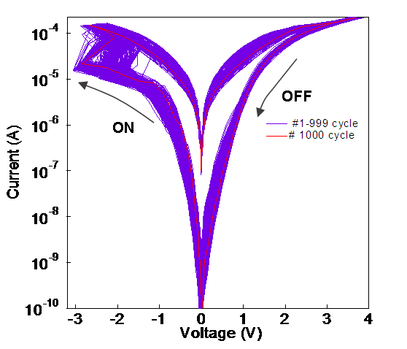
Understanding Memristor Microphysics
+
Pt
30nm – 10μm
V
-
TiO₂
Pt
20 nm
An accurate, predictive circuit model needs a good microphysical model
Key questions:
What are the important physical processes involved in switching (heating, drift, diffusion)?
Role of oxygen vacancies (n-type dopants), electromigration, dielectric breakdown, migration of the metal electrode atoms? Metal/oxide schottky-barrier physics, electrochemistry, etc.
Approach: materials/device characterization + electrical modeling

Slide 20
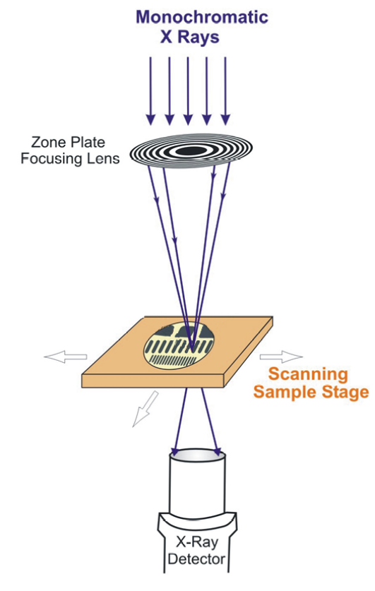
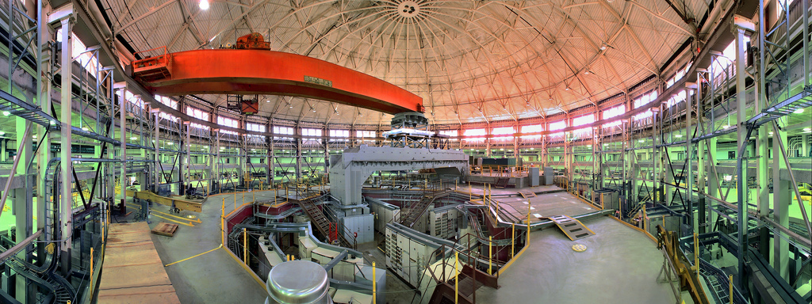
Getting nanoscale chemical resolution: STXM at the Advanced Light Source, Berkeley
Scanning Transmission X-ray Microscope (STXM)
Spatial resolution down to 25nm
Probes entire depth of sample
Energy resolution (70 meV) for chemical identification

Slide 21
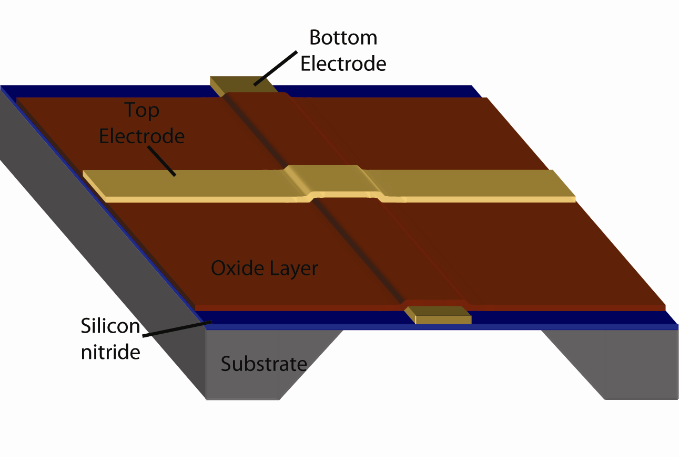
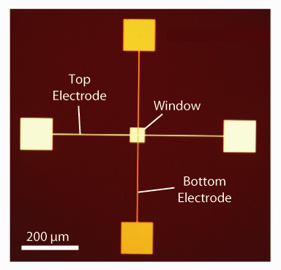
X-ray spectromicroscopy and TEM of TiO₂ NV memristor
Devices fabricated atop thin Si₃N₄ windows
Photograph of actual device
2009
Window
Allows:
1. Non-destructive characterization (no delamination or cross-sectioning)
2. X-ray or Electron microscopy of same device
3. In-situ electrical addressing of device during characterization

Slide 22
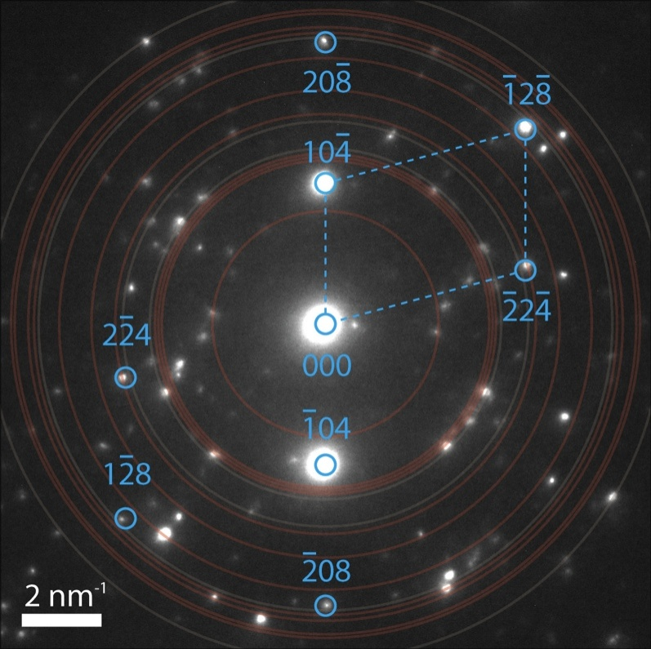
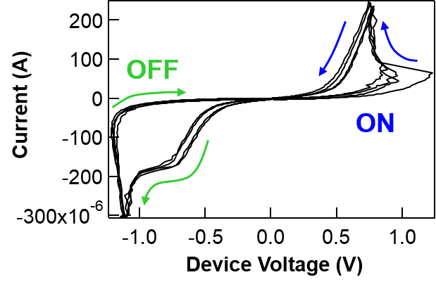
Chemical/Structural Mapping by XAS
TEM - Electron diffraction
TiO₂ Amorphous
Diffraction pattern identifies the reduced phase as crystal Ti₄O₇
8
TiO₂ Anatase
TiO_{2-x} Reduced
6
Ti₄O₇ is:
Stable sub-oxide of TiO₂
Member of Ti_{n}O_{2n-1} Magneli phases
Metal-Insulator Transition 140-150K
Absorption (a.u.)
4
J.P. Strachan, M.D. Pickett, J.J. Yang, S. Aloni, A.L.D. Kilcoyne, G. Medeiros-Ribeiro, R.S. Williams, Advanced Materials 22, 3573 (2010)
2
0
455
460
465
470
X-ray energy (eV)

Slide 23
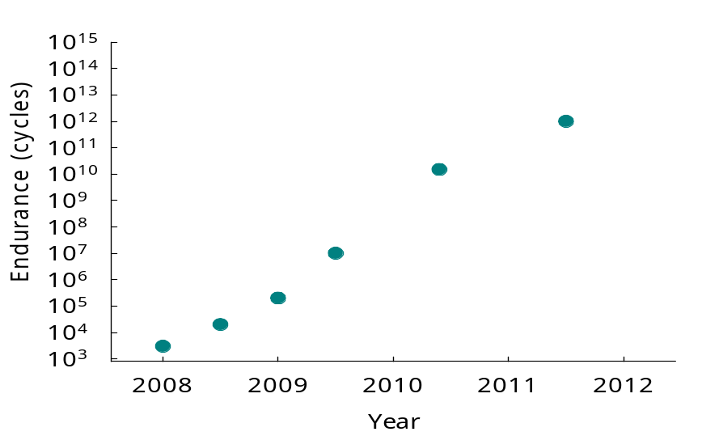
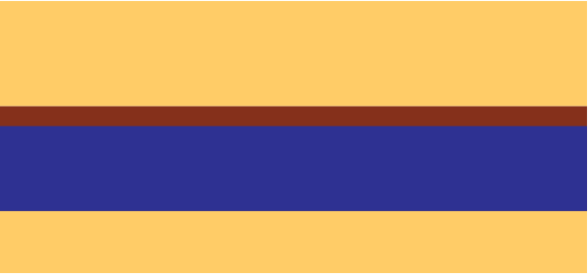
Ramifications of the X-ray characterization
Deliberately engineer devices with Ti₄O₇ layer from the beginning to eliminate “electroforming”
Broad range of stable phases Ti_{n}O_{2n-1} for n>2, suggests many “intermediate states” can form, limits cycling endurance
Pt / 35nm “Ti₄O₇” / 5nm TiO₂ / Pt
Simpler phase diagram of TaO_{x} system 10⁶ → 10¹² endurance
TiO₂
Pt
TaO_{x}
Ti₄O₇
Pt
TiO₂
Yielded lower voltage operation and lower variability

Slide 24
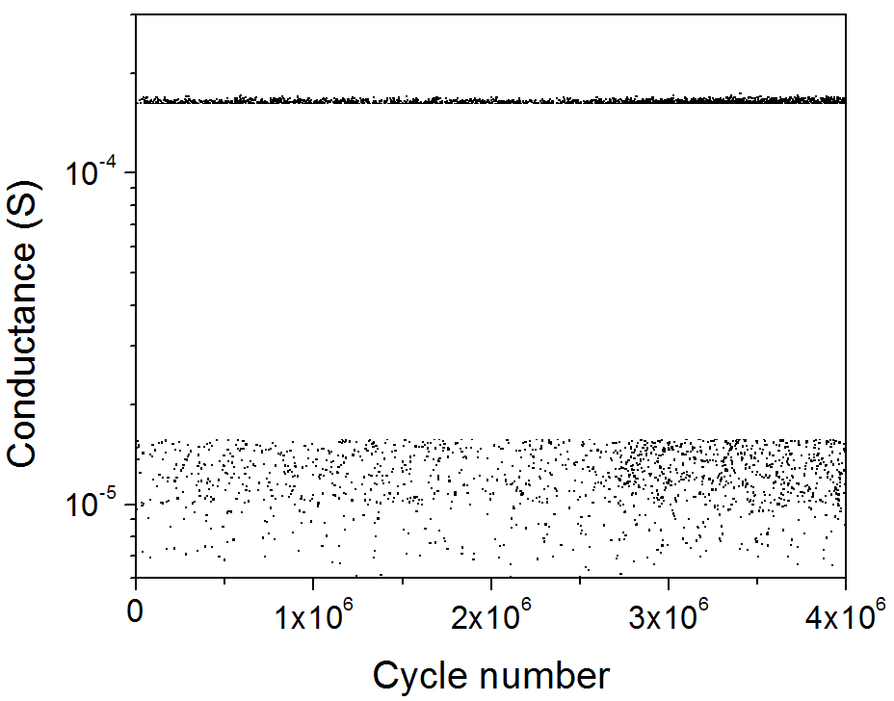
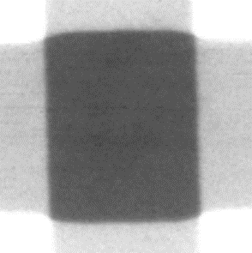
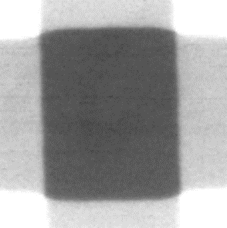

2015
in operando analysis of TaOx
ON
Applied roughly +1.25 V, -2.0 V
Only imaging device states with
G_{ON} > 1.5e-4 S (~ 6 kΩ)
G_{OFF} < 1.5e-5 S (~66 kΩ)
Gating
pulses
OFF
ON
✓
✗
✓
✗
✓
Device
pulses
0
t
OFF
X-ray
pulses
2 μm
Despite large conductance change, material changes are extremely small and no localization observed for small power operation
+0.05
ΔOD
X-ray intensity
0
I_{OFF}
I_{ON}
ln (I_{OFF}/I_{ON})
-0.05
Within crosspoint area, Abs_{OFF} - Abs_{ON} = +0.0015 ± 0.0002 (SNR ≈ 7)
Outside of crosspoint area, No signal above noise level

Slide 25
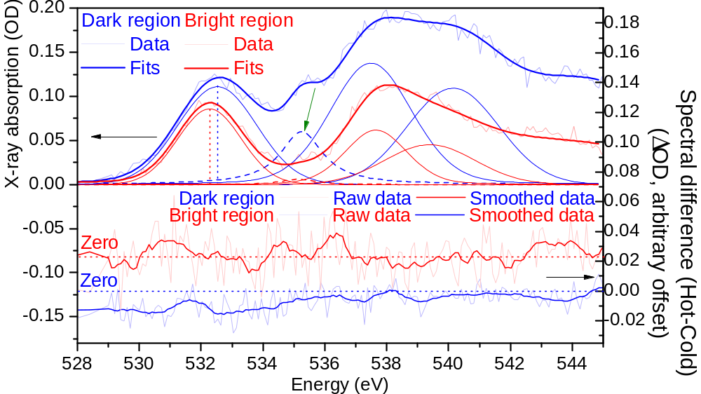
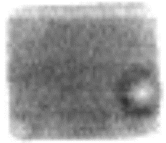
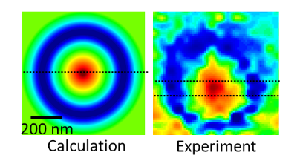
Spectroscopy of device regions: field and temperature effects
2 μm
X-ray intensity
“dark” region
“bright” region
Additional experiment: Apply +V vs 0V and look for Joule heating
Thermal effects seen in bright region – localized current flow in bright region only!

Slide 26
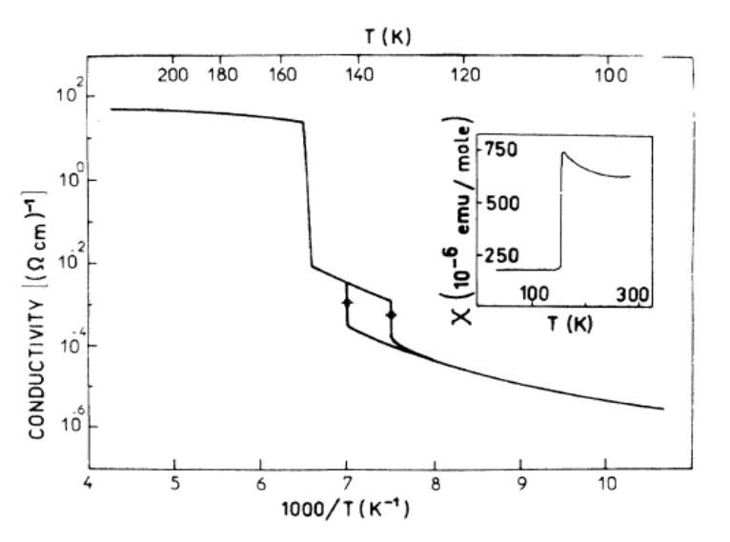
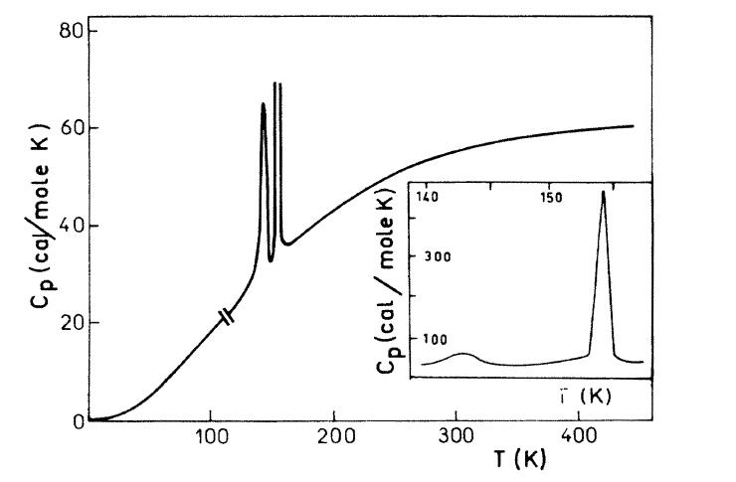
Many metal-oxides exhibit Mott Transitions
Correlated-electron insulator to conductor phase change
The basis for a locally active memristor
Ti₄O₇ Metal-Insulator Transition 140-150K
Lakkis et. al, PRB, (1976)

Slide 27
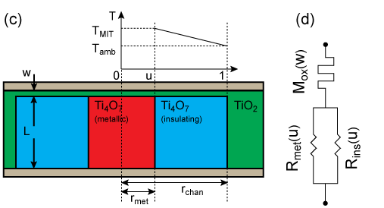
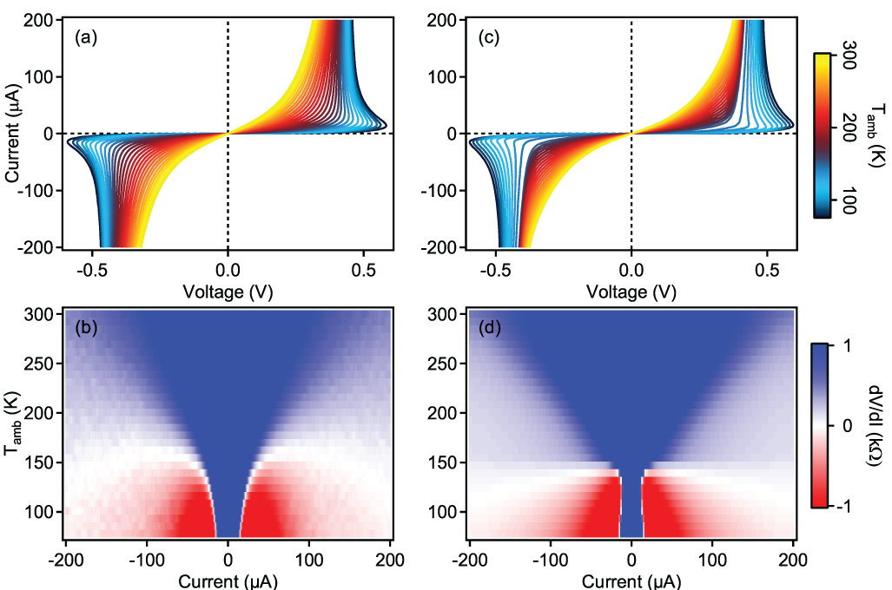
Identification of local activity (NDR) in Ti₄O₇
Metal-Insulator transitions in metal oxides provide a new functionality we can exploit
Presence of Ti₄O₇ explains Negative Differential Resistance effect
Data
Simulation
Data
Simulation
Current through device → Joule heating → growing metallic phase within Ti₄O₇
M. D. Pickett, et al. Advanced Materials, (2011)

Slide 28
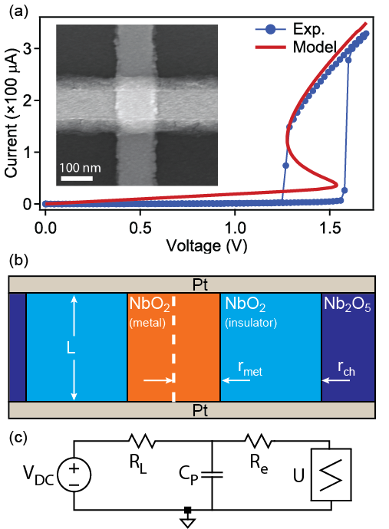
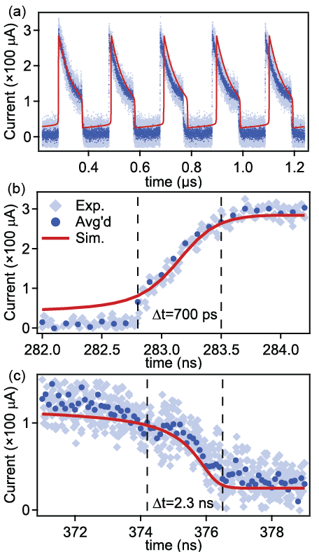
NbO₂ Locally Active “Mott” Memristor – thermoelectric switching
Oscillator with DC bias!
r_{ch} =
30 nm

Slide 29
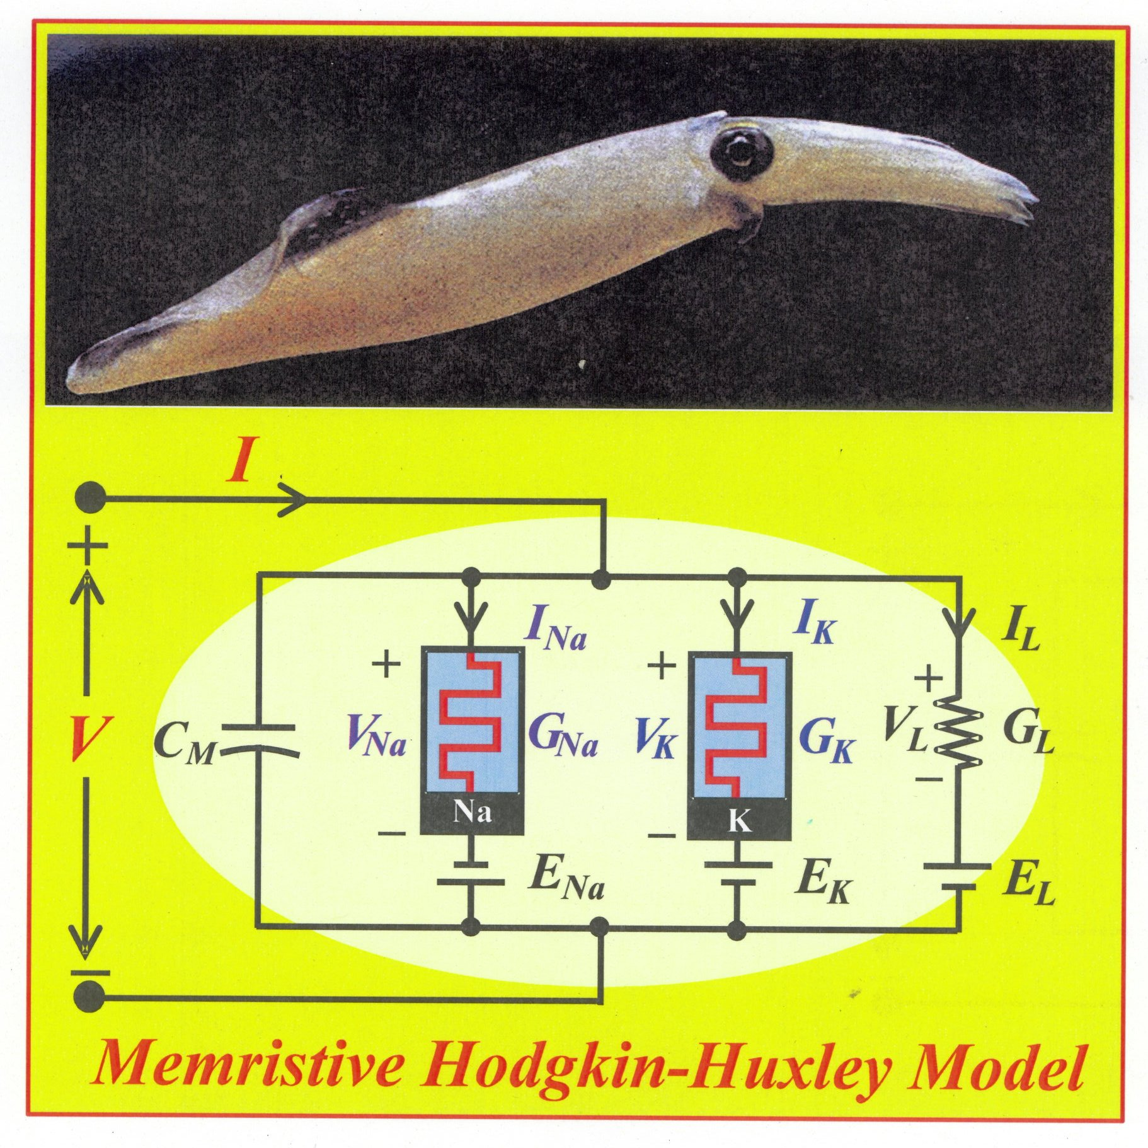
Leon Chua’s Version of the Hodgkin-Huxley Model
L. Chua et al., “Hodgkin-Huxley Axon is made of Memristors,”
International Journal of Bifurcation and Chaos 22 (2012) art. # 1230011.

Slide 30
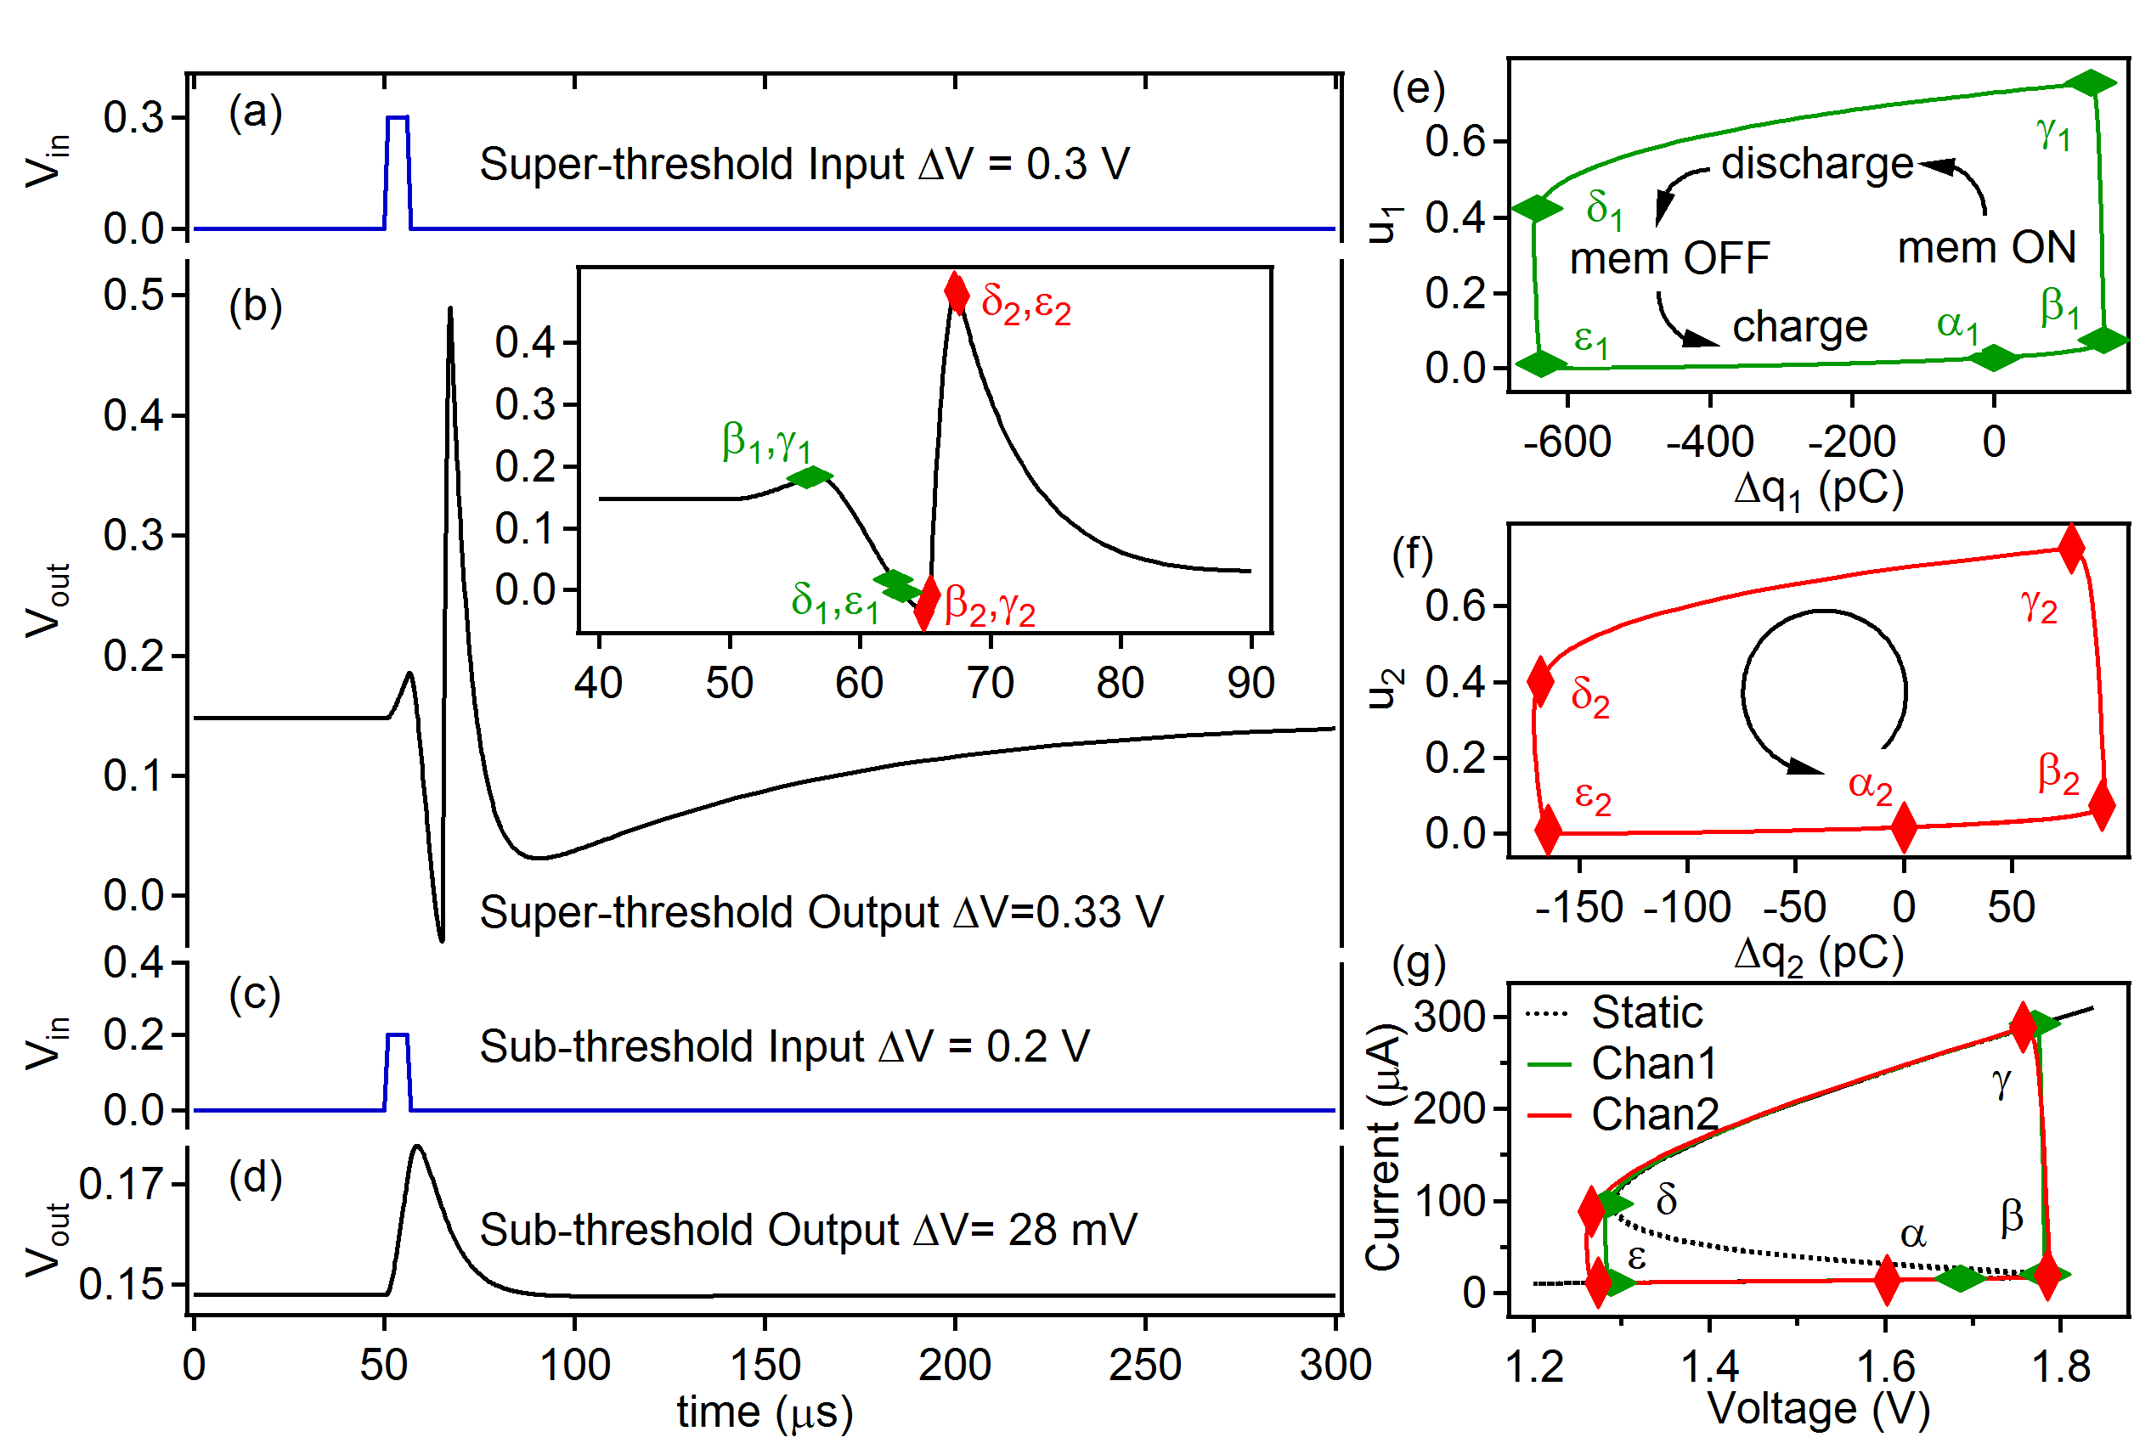
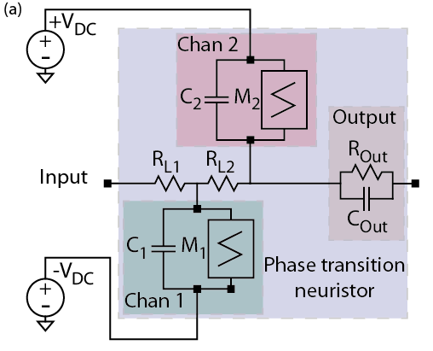
A Neuristor inspired by the Hodgkin-Huxley model
Implements “All or Nothing” spiking:
1000 times faster than a neuron
1% of the energy of a neuron
M. D. Pickett, et al, Nature Materials 12, 114 (2013).

Slide 31
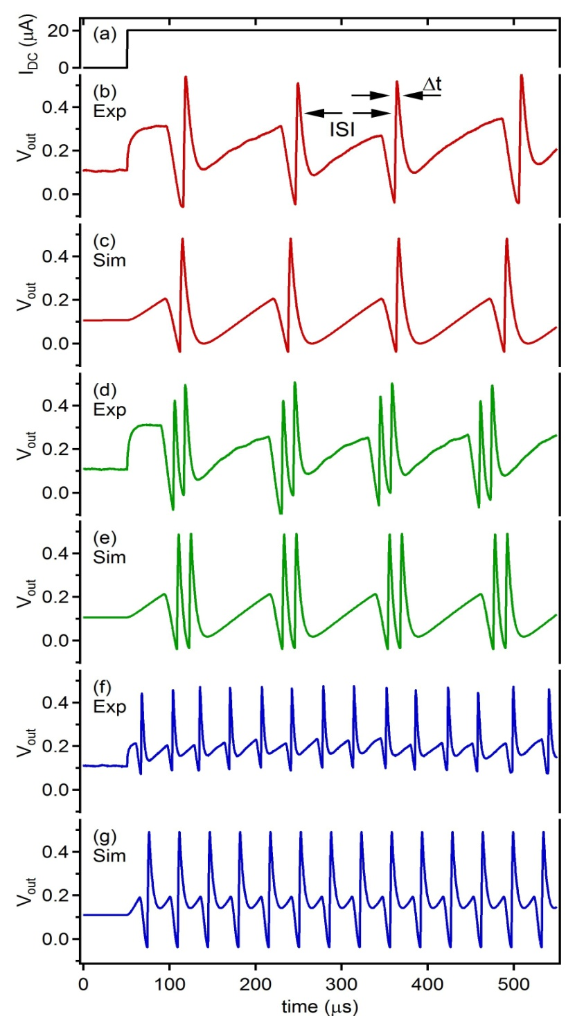
Neuristor Spiking
emulates signals
seen in brains
“Regular Spiking”
C₁=5.1 nF, C₂=0.75 nF
“Chattering”
C₁ = 5.1 nF, C₂ = 0.5 nF
Compared to brain
500x frequency
4x V amplitude
1 % of energy/spike
“Fast Spiking”
C₁=1.6 nF, C₂=0.5 nF

Slide 32
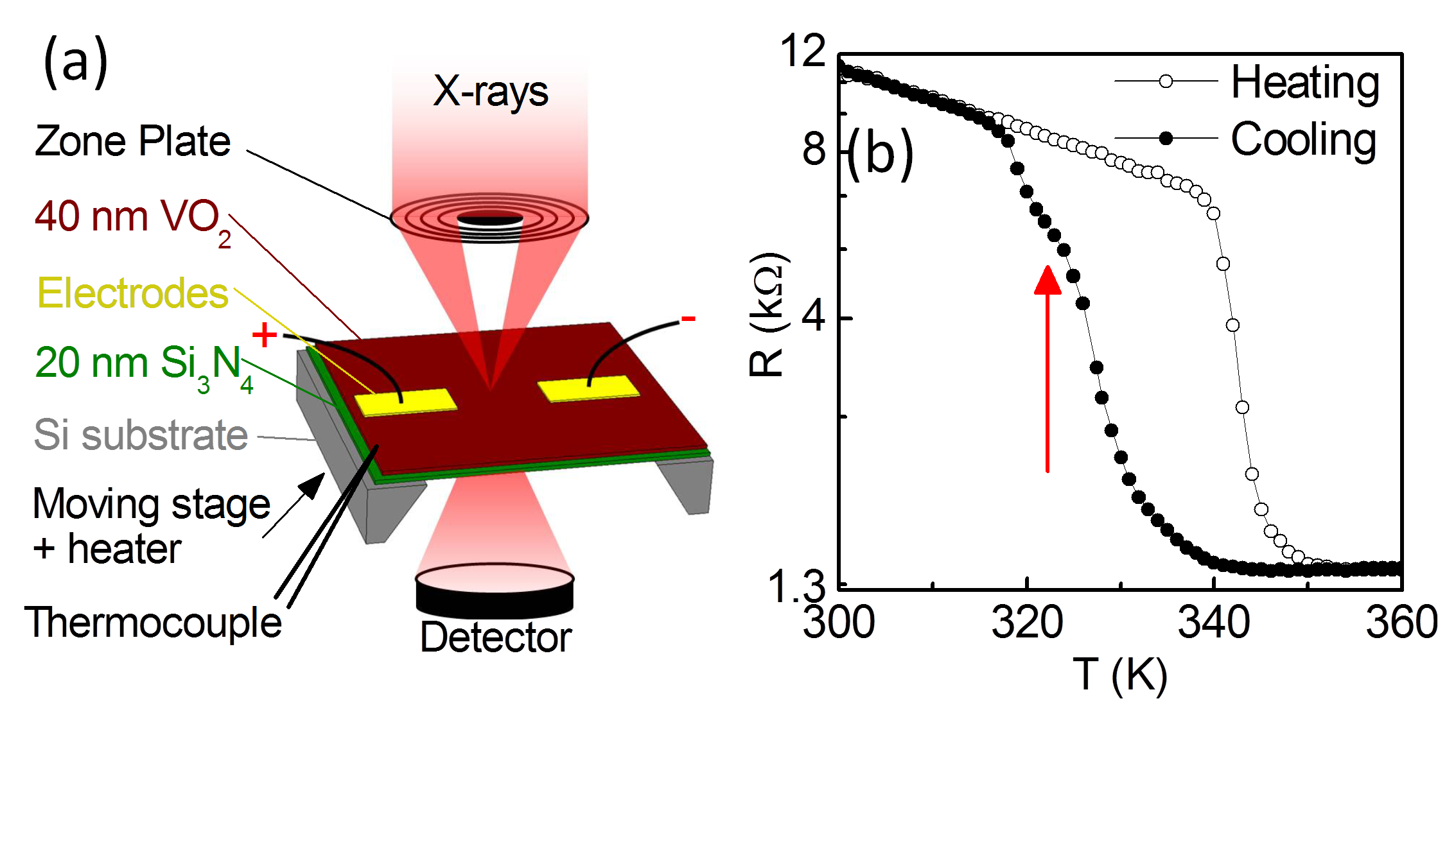
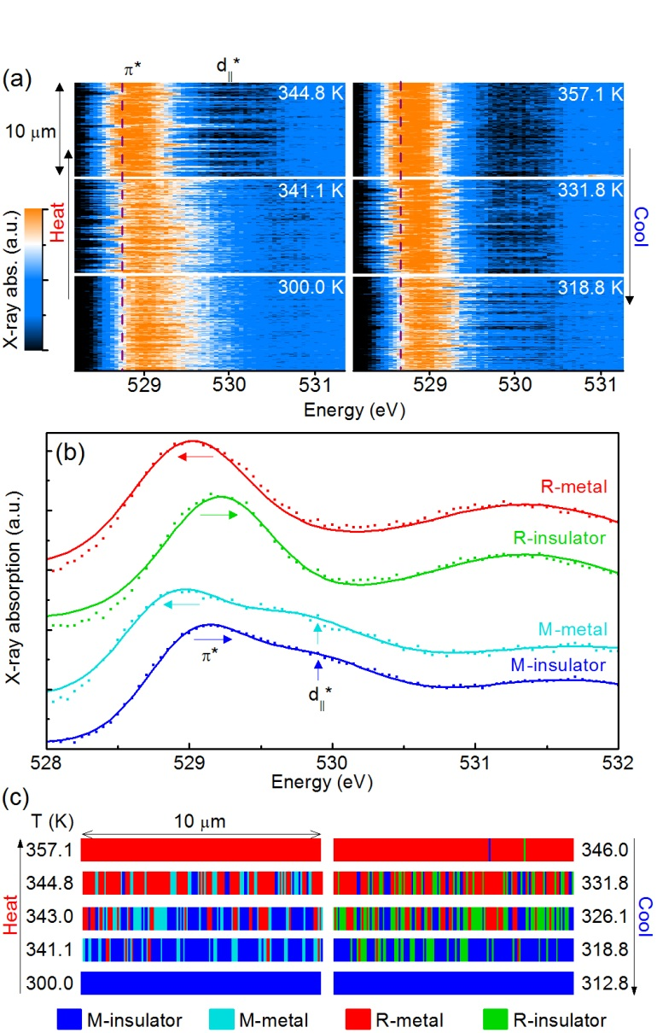
Drove our research into phase transition materials/devices
In VO₂, local heating drives Mott-Peierls transition = locally active memristor
Measure T also!
Identified two unknown metastable phases!
X-ray structural and electronic mapping shows the Mott and Peierls transitions are not simultaneous
S. Kumar, et al., Advanced Materials, (2014)

Slide 33
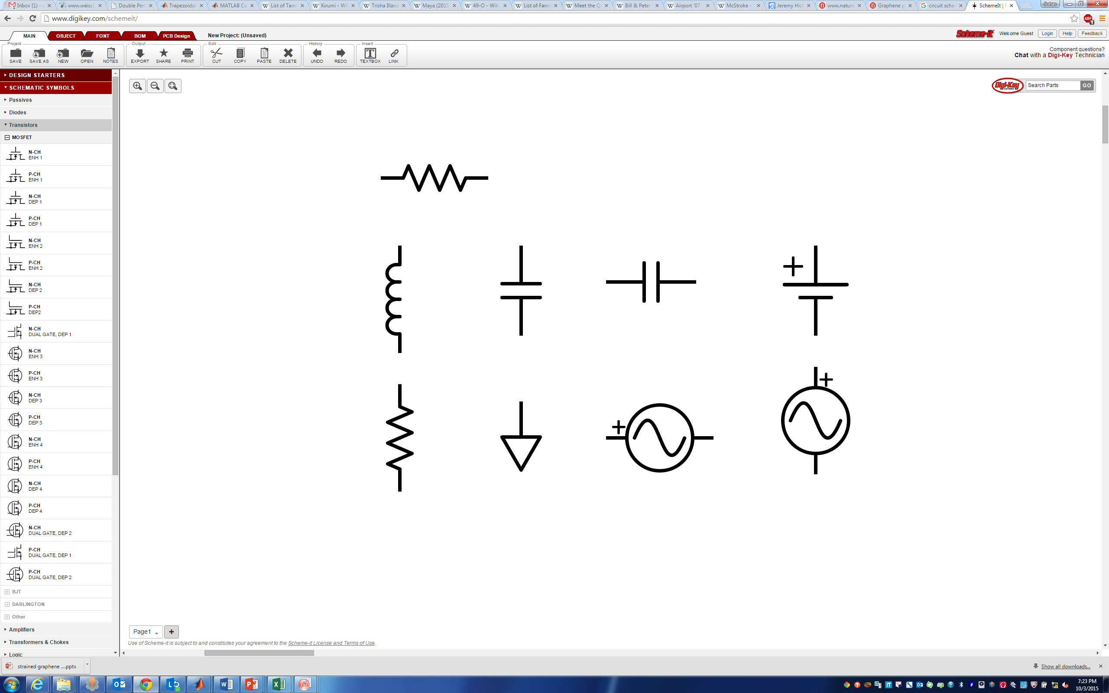
Integrated Mott memristors – thermoelectric design
Pt top electrode
TiN
NbO_{x}
T_{N}
R_{th}C_{th} ≤ 0.1 ns
R_{th} ≥ 10⁶ K/W
C_{th} ≤ 10⁻¹⁶ J/K
10x faster
0.1x energy
of previous device
R_{th}
≤ 0.1 nF
SiO₂
C_{e}
TiN
Nanovia
C_{th}
SiN_{x}
T_{amb}
W bottom electrode
Dark field cross-sectional TEM image of NbO_{x} memristor. The heated region is thermally connected to T_{amb} through the effective thermal resistance, R_{th}, and thermal capacitance, C_{th}.

Slide 34
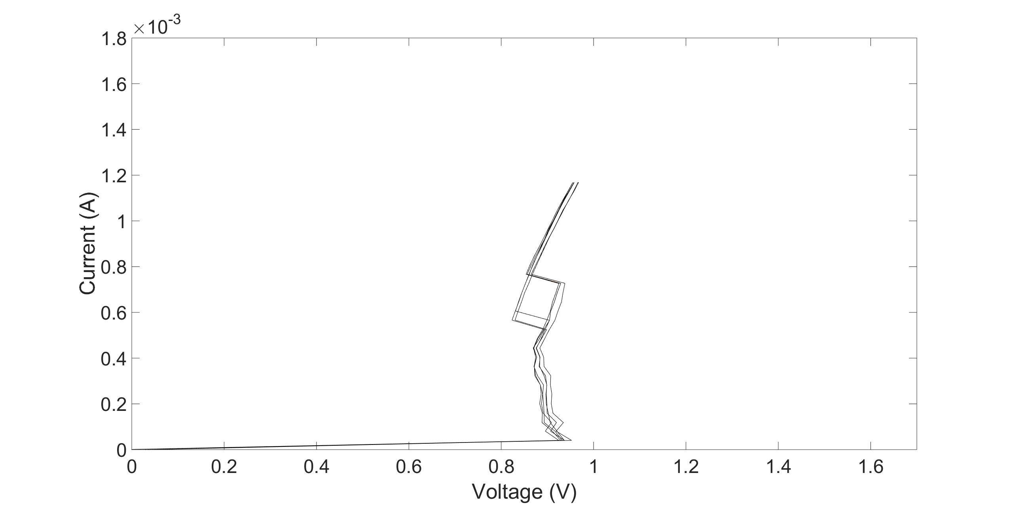
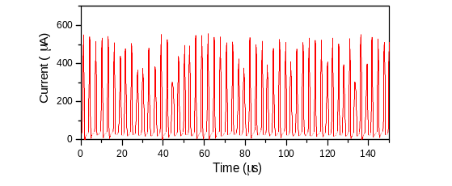




New NbO₂ memristor displays oscillatory and chaotic behavior
Oscillations and chaos depend sensitively on DC bias
DC characteristics
0.96 V
1.00 V
Oscillations
1.03 V
1.20 V
Oscillations
R1=1kΩ
R2
C1=1nF
M
C2

Slide 35

Next step: from individual device to an entire (model) circuit
in situ and in operando analysis of a circuit.
Applied voltages induce local heating and field-effects modifying structure and composition at the nanoscale

Slide 36
Further applications of SR for circuit analysis
Mapping of chemical/structural/electronic properties
~5 nm in situ spatial and ~1 ns in operando temporal resolution
Coherence enables 3D analysis
As devices scale down in size, interfaces and sidewalls dominate the properties
Interfaces with top and bottom electrodes affect the electronic properties
Sidewall reactions with interlayer dielectric (ILD) can create “dead” zones or shunting paths
Vacancy/oxygen diffusion can limit cycling lifetimes
M2
Via
Bit
M1

Slide 37
Some thoughts on ALS applications for computing
Driving “More than Moore” functionality for neuromorphic computing
  Semiconductor size scaling will eventually reach 5 nm – need to look inside the devices
  Fundamental shift: New devices are now viable to complement CPUs (hardware accelerators)
  → Exploration of novel devices and functionalities integrated on top of CMOS
  Chemical/electronic/structural information at these length scales is a critical need
  Brightness is the compelling feature that allows mapping
  Opens up “material discovery” rather than just heroic device characterizations
  Our research at ALS led to fundamental materials understanding, which enabled the discovery of ‘locally active’ Mott memristors and in turn the invention of a solid-state neuristor

Slide 38




Acknowledgements for SR studies
HP
John Paul Strachan
Suhas Kumar
Cat Graves
Gary Gibson
Miao Hu
Warren Jackson
Emma Merced
Feng Miao
Matthew Pickett
Antonio Torrezan
Jianhua Yang
Max Zhang
Molecular Foundry, Berkeley
Shaul Aloni
Advanced Light Source, Berkeley
David Kilcoyne
Andreas Scholl
Tolek Tyliszczak
Advanced Photon Source, Argonne
Martin Holt
Volker Rose
Tel-Aviv University
Ilan Goldfarb
UC Santa Barbara
Dima Strukov

Slide 39
Neuro challenges a larger community than just nano
Need to go beyond NNI and involve diverse creative communities
Information technology requires a system-level awareness: Architecture
  Nano devices and circuits will be necessary, but not sufficient for a paradigm shift
  Also need insights from neurophysiology (circuits) and psychology (algorithms)
Revolutionary advances disguised as evolutionary to gain market acceptance
  A new nanodevice is useless if it requires a major change (i.e. expense) to a system or to manufacturing processes (customers don’t pay for performance – they expect it)
  Two-thirds (or more) of any computing system today is design and software
Avoid fads and bandwagons (e.g. Graphene and Deep Learning)
  Need a broad investment portfolio of competing technologies and ideas
Multi-disciplinarity is essential – need experts in each domain who can communicate, not lots of broad but shallow neophytes

